Slide 1
Cows, Populists, and Miners

Slide 2
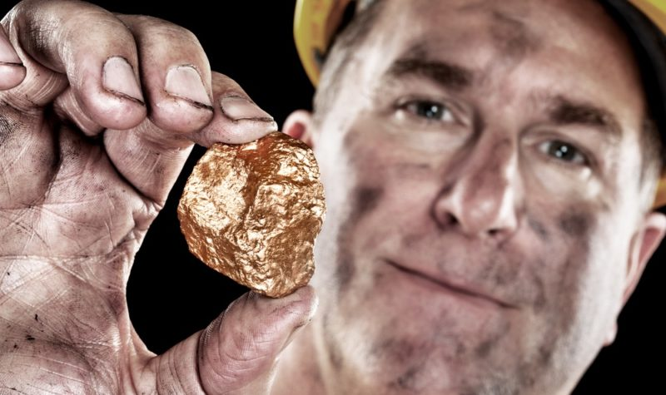
So Anyways…
Remember the Indians? Yes? Well one of the reasons the U.S. government wanted them gone was to have access to the sweet juicy minerals of the west.
So the book makes a big issue about the way people mined. Essentially they just dug holes and tunnels and such and scooped up the metal goodness. The point is, many Americans moved west because they wanted gold, silver, copper etc.
This led to boom towns. You’ll probably have to know that.

Slide 3
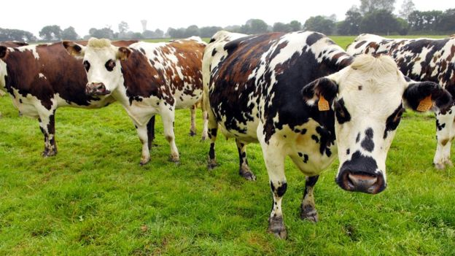
And now…

Slide 4
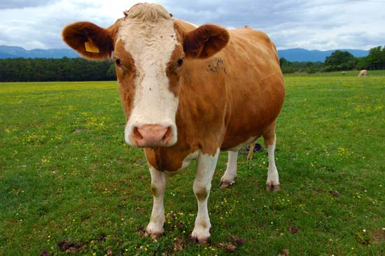
What you’ve all been waiting for…

Slide 5
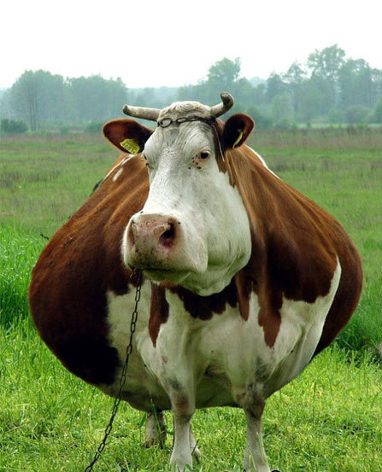
The very apex of your history education…

Slide 6
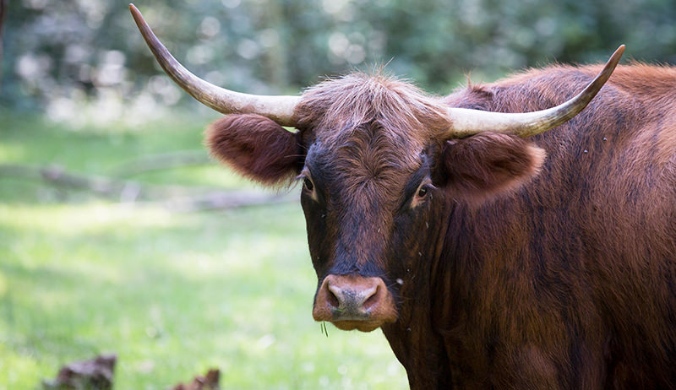
I present to you…

Slide 7
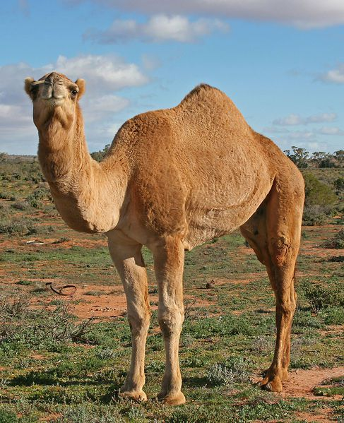
The most exciting thing you will ever learn..

Slide 8
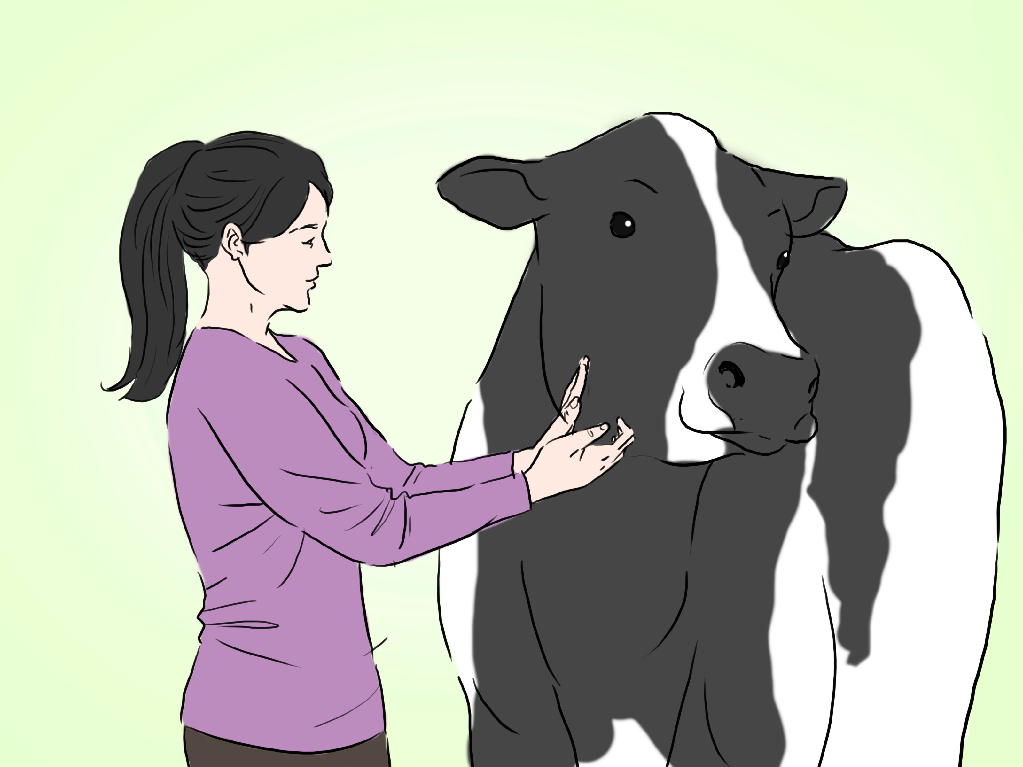
CATTLE!

Slide 9
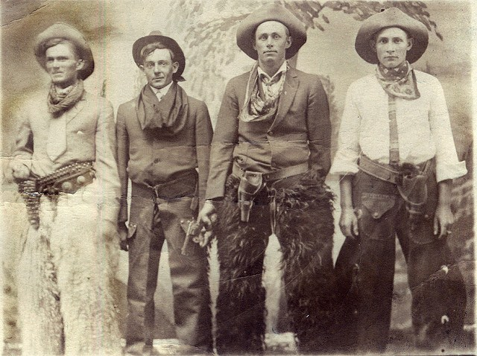
Cattle and the West
So basically the western U.S. is not the greatest place for growing things. It’s pretty arid. However, you can graze cattle there.
The problem is, if you graze cattle in the west, and your market is in the east, you need to find a way to get the delicious juicy cows to the consumers.
So…Cowboys. They are like dog walkers, but for cows. They move cattle off the open range along well known trails (such as the Chisolm Trail) to railroads. (More about the railroads later.) The cows get on the train, thinking they’re going to the park. But instead they are taken to slaughter houses. Anyway there’s a map in your book on page 130. Check it out. Talks about the long, drive etc.

Slide 10
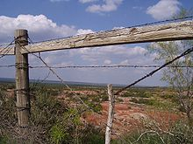
End of the open range
So the cattle are cavorting around the west like big dogs at Markham Park.
THEN, a bunch of farmers showed up and got annoyed about the cattle trampling their fields.
Also, the ridiculous amount of cattle was driving the price of beef down. I personally don’t think there is any such thing as too many cows, but apparently there is.

Slide 11
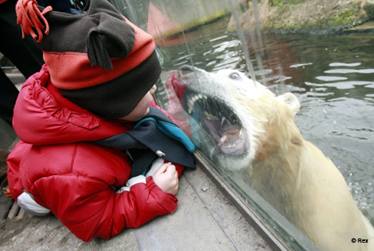
Oh, back to gold.
In 1897 gold is discovered in Alaska.
The Klondike gold rush began!
In order to get to the gold, the miners needed to get past the polar bears.
The technique was to send a bunch of younger, less experienced miners in first (freshman age). Once the polar bears had feasted on them and were laying around full and satisfied the rest of the smarter miners would rush past and get rich.

Slide 12
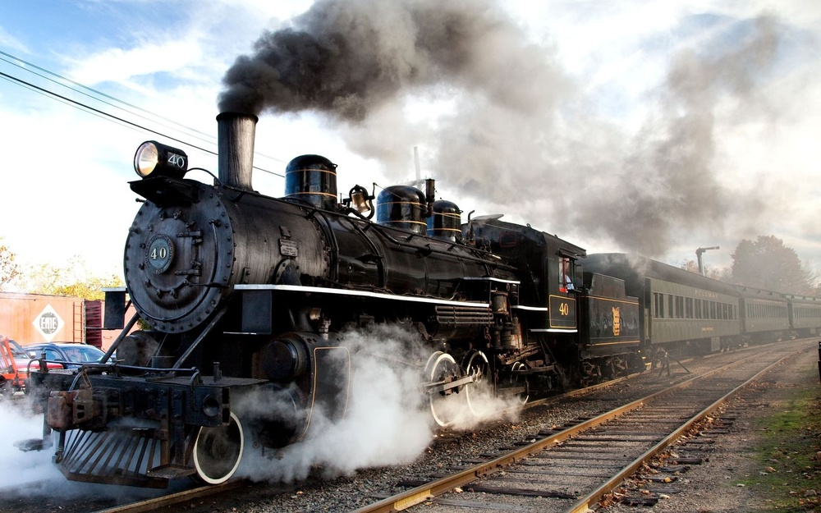
Ok…Settling the Great Plains
Railroads!
So from 1850 to 1871 made land grants to the railroads.
The book expects you to know what this means. I know you don’t. So I’ll explain.
Some of the more successful railroads were, the Great Northern and the Union Pacific.
These railroads brought commerce and settlers to the west, and there was an incentive to invest in these endeavors.

Slide 13
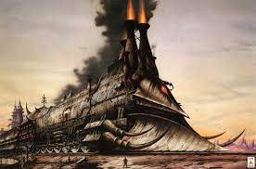

Slide 14
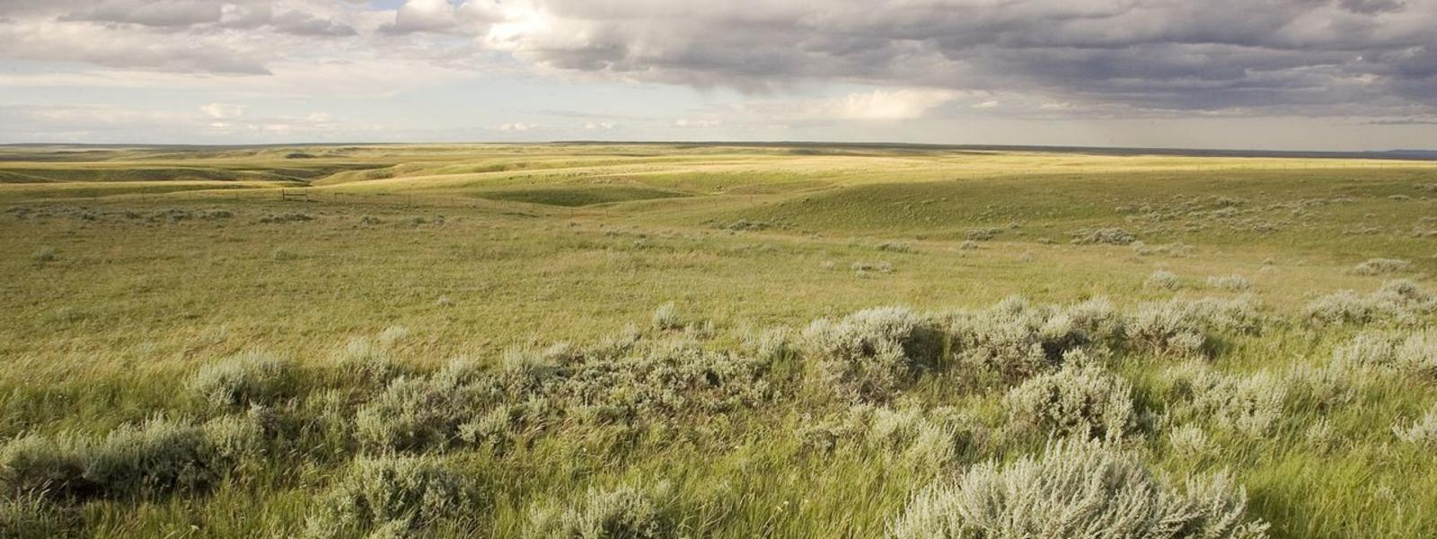
Also…
The U.S. government decided to give land away. The argument was sell the land or give it away.
It made more sense to give the land away, because it increased the prosperity of the U.S. overall, and in it’s way it was more democratic.
Rather than having large rich landowners, you end up with average Americans.
The Homestead Act was passed in 1862 and it gave land to U.S. settlers in 160 acre parcels. This worked pretty well in the East, but not so well in the West. Also, it only passed in 1862 because before the Civil War slave owners were against it. That’s why the Freesoiler party was against slavery. If you are sleeping through this part and read the power point later you will probably be very confused. So LISTEN to the explanation of the above.

Slide 15
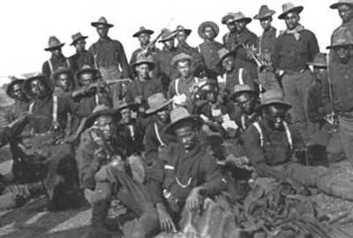
Exodusters
After 1870 many of the freed slaves and blacks in general sought a more free and equitable lifestyle in the west.
These black settlers were called exodusters. It will probably be on the EOC. Either way it’s a pretty important piece of American History.
You’re welcome.

Slide 16
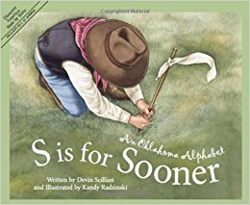
Sooners
Did you ever wonder why people from Oklahoma call themselves “Sooners”?
Is it because the Sooner State is more catchy than the “Depressed by all the Dust State”?
No, it’s a mix of American impatience and bad grammar.
2,000,000 Americans rushed to settle Oklahoma in 1898 for some reason, and some rushed across the border early to find the best pieces of land (joke was on them though, there WERE NO best pieces, only some areas that were less brown.)

Slide 17

Also…
The Morrill Acts of 1862 and 1890 were created to encourage Americans to become better farmers. They worked pretty well, and most of us have benefitted from them. Then Monsanto came along and screwed it all up.
I’ll explain…
And then the Hatch Act was created to not build colleges, but invest in making the colleges agricultural experiment stations. This was in 1877. Today most Land Grant Colleges are know less for agriculture and the contribution of knowledge to American citizens (and others) and more for how many stupid kids end up in the hospital as a freshman due to alcohol poisoning. Progress!

