Slide 1
The New Immigrants

Slide 2
Ellis Island
Operated as the chief immigration center from 1892 to 1924.
98% of immigrants coming through Ellis Island were allowed to immigrate.
In 1924 most immigration had stopped…
Wait for explanation.

Slide 3
Angel Island
Not the same experience as Ellis Island
Immigrants were kept in cells and many were turned back.

Slide 4
The Rise Of Nativism
Nativism is basically the idea that the only people that matter in the U.S. are white, protestant people that were born in the U.S.
Nativists were less concerned about immigration of people from the “right” countries.
Prescott F. Hall founded the Immigration Restriction League. In their opinion desirable immigrants were:
  British
  German
  Scandinavian
Undesirable were:
  Slav
  Latino (or Latin in General including Spain, Italy, Portugal etc.)
  Asiatic
  People that were traditionally downtrodden

Slide 5
Anti-Asian Sentiment
Chinese Exclusion Act:
  Banned all Chinese except for students, teachers, merchants, tourists and government officials.
  This was enacted in 1892 and finally repealed in 1902.

Slide 6
The Gentlemen’s Agreement
This was a deal between the U.S. and Japan crafted between 1907 and 1908.
Japan agreed to restrict immigration of unskilled workers in exchange for San Francisco lifting the school segregation ban.

Slide 7
The Settlement House Movement
These were places immigrants could go to find food, clothing, shelter and education.
This is part of the Social Gospel Movement
Jane Addams and Ellen Gates Starr founded Chicago’s Hull House in 1889.
Other Social Gospel Organizations included:
  The Salvation Army
  The YMCA

Slide 8
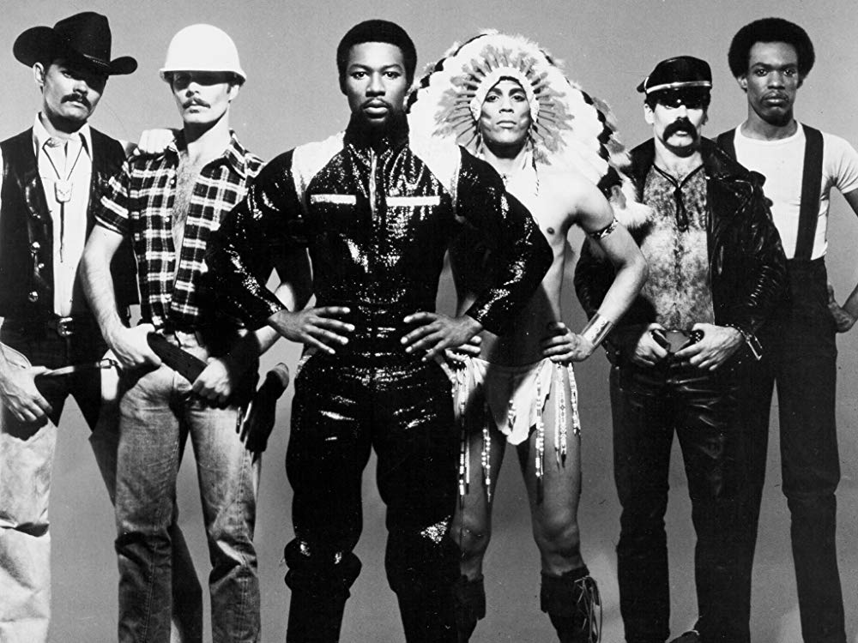

Slide 9
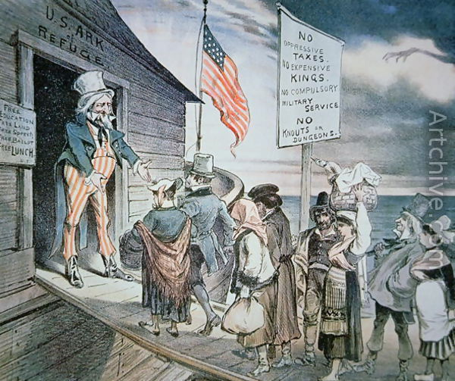

Slide 10
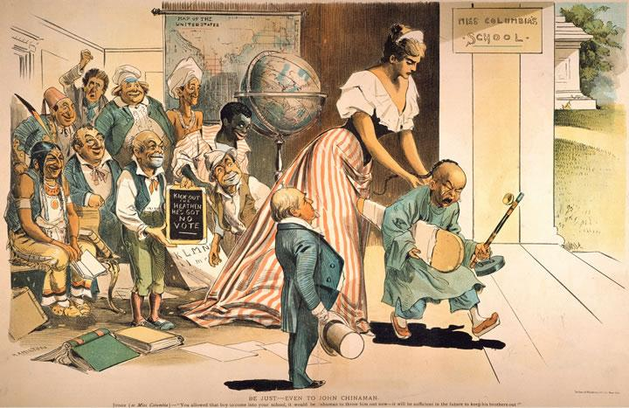

Slide 11
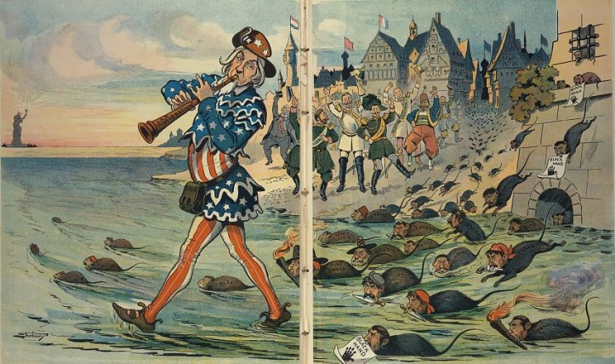

Slide 12
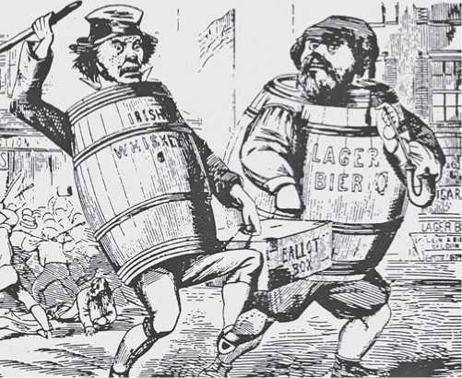

Slide 13
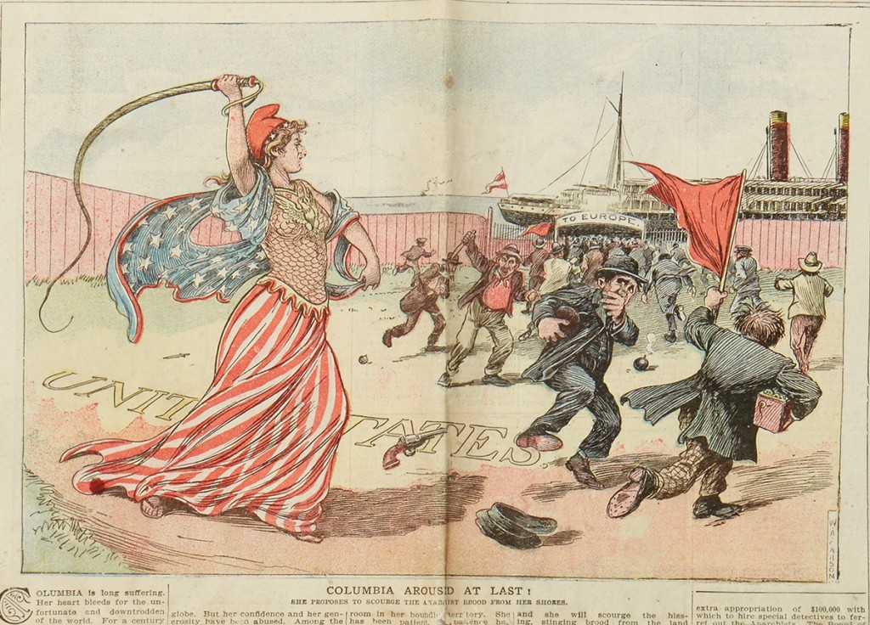

Slide 14
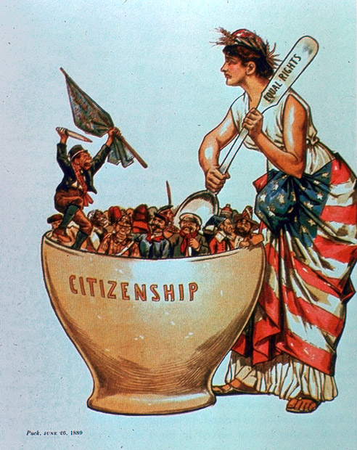

Slide 15
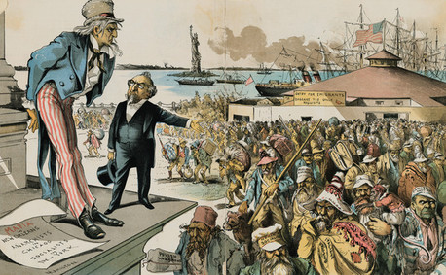

Slide 16
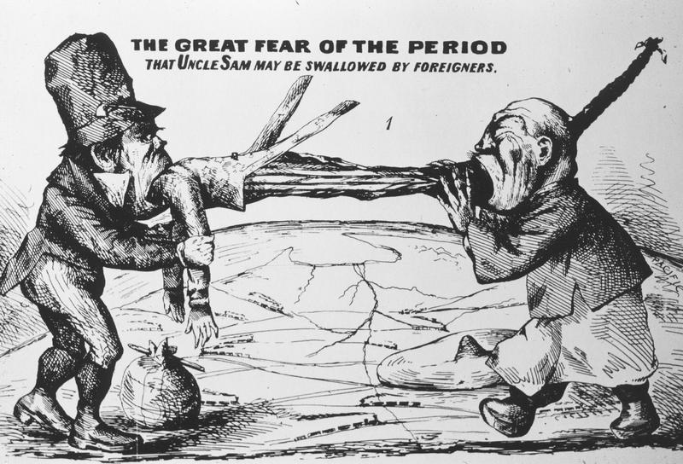

Slide 17
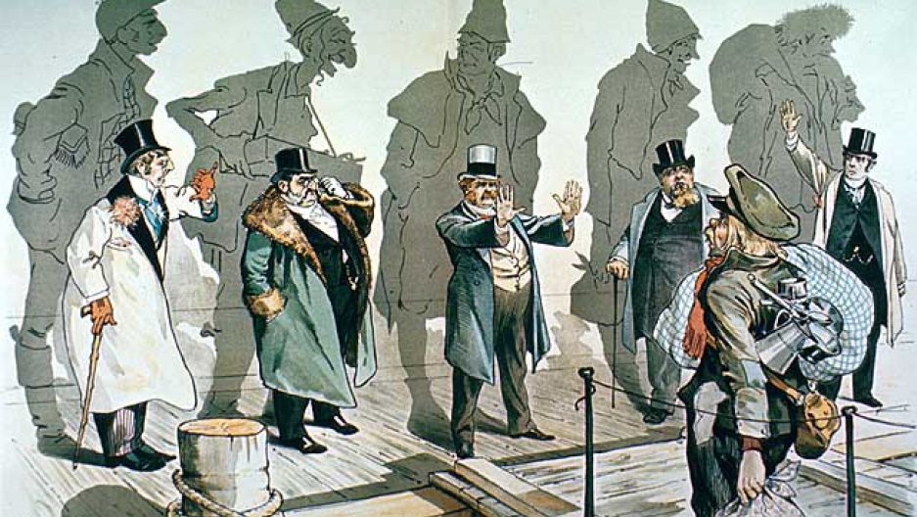

Slide 18
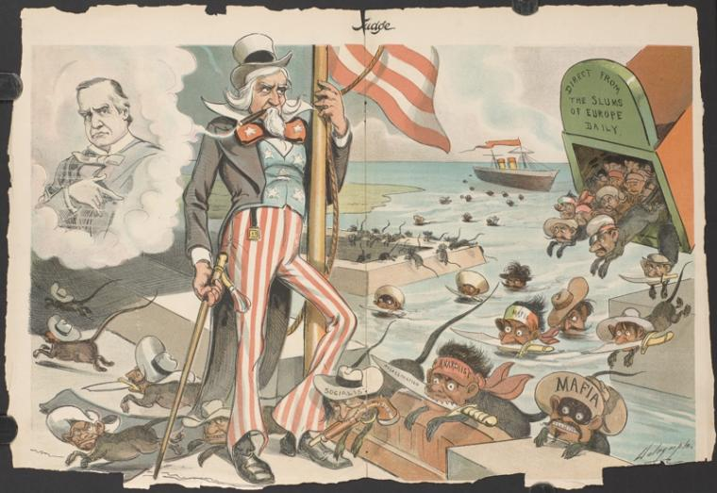

Slide 19
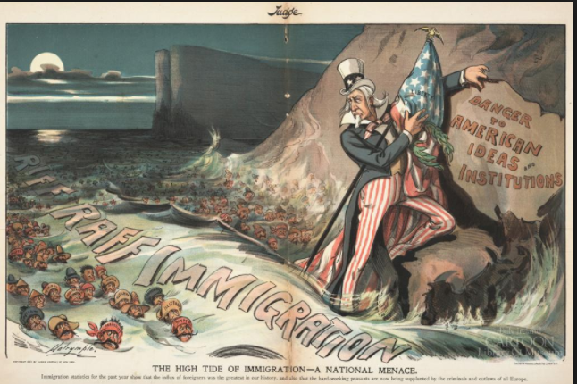

Slide 20
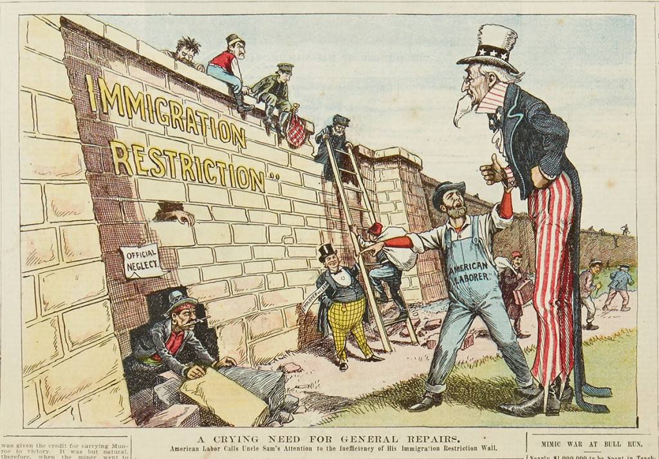

Slide 21
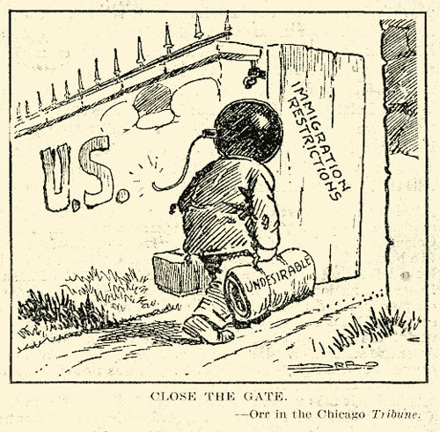

Slide 22
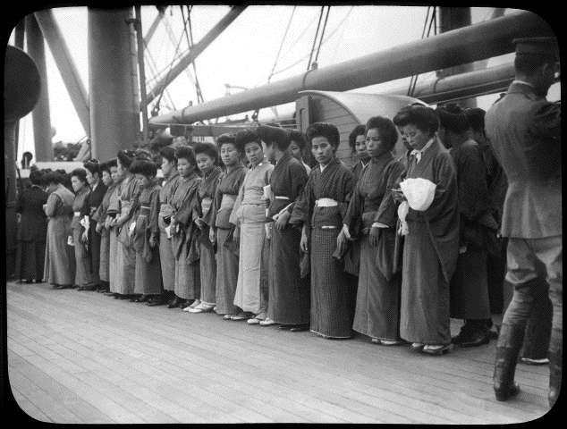

Slide 23
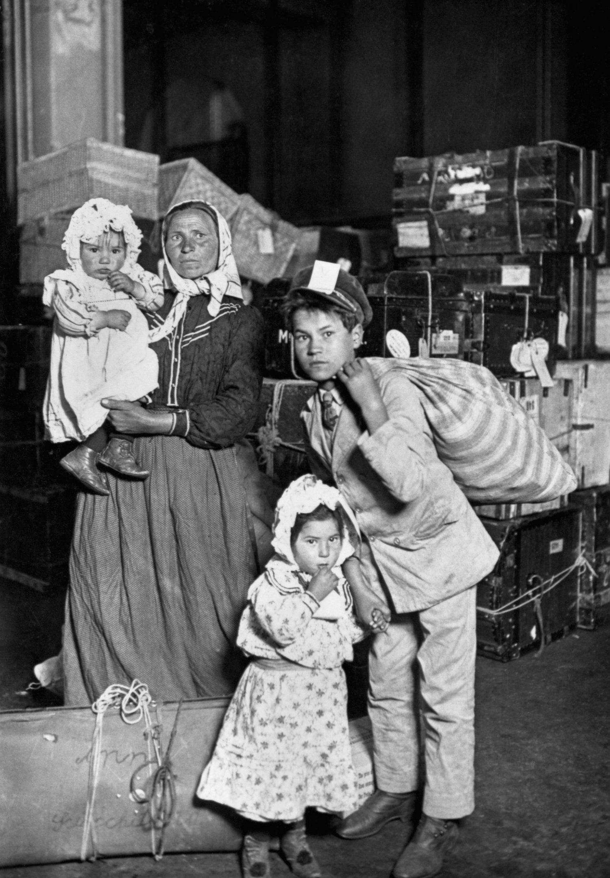

Slide 24
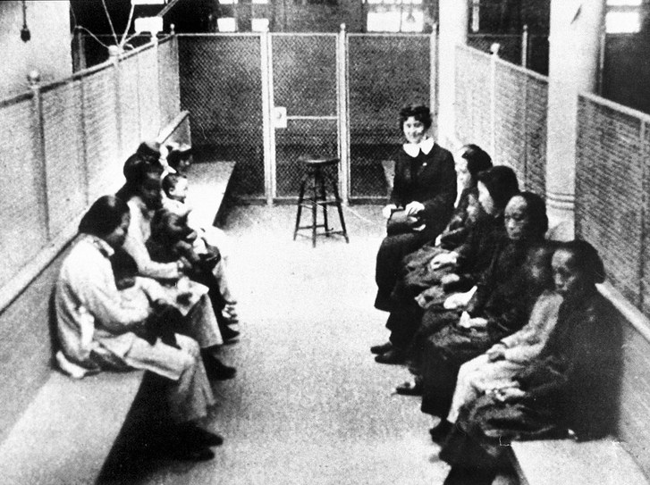

Slide 25
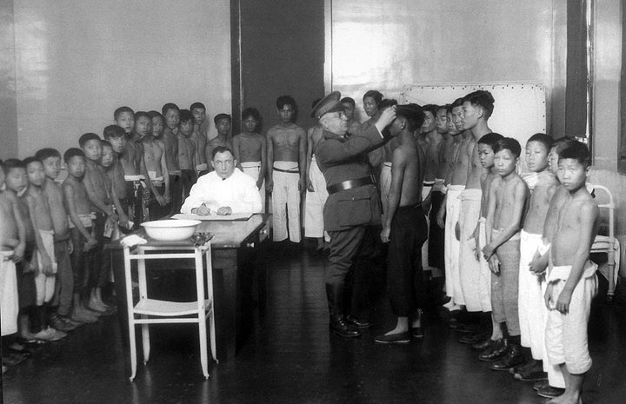

Slide 26
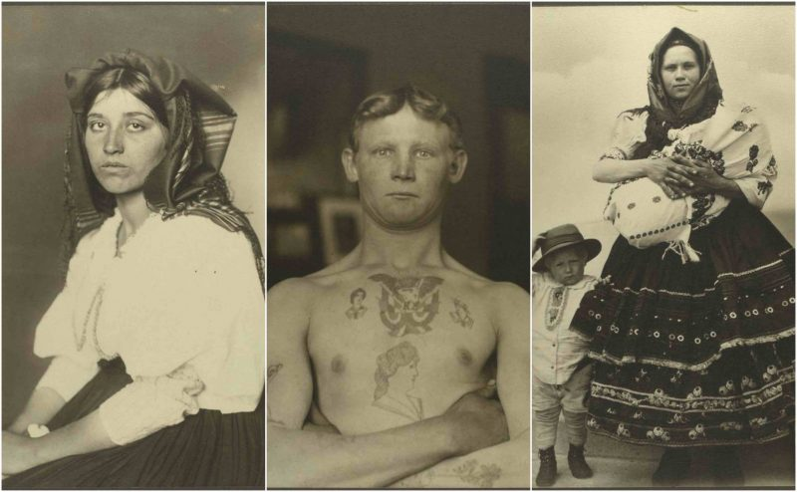

Slide 27
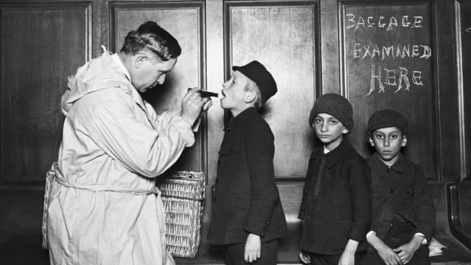

Slide 28
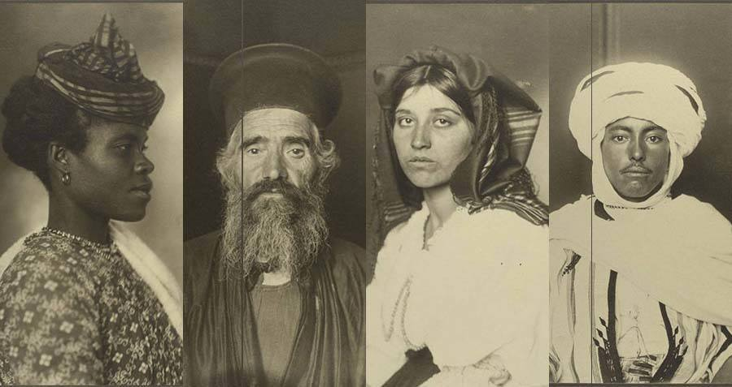

Slide 29
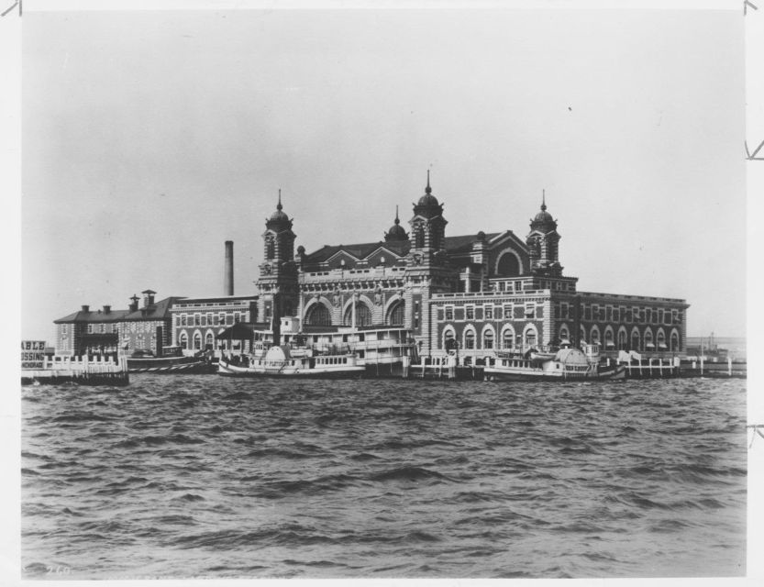

Slide 30
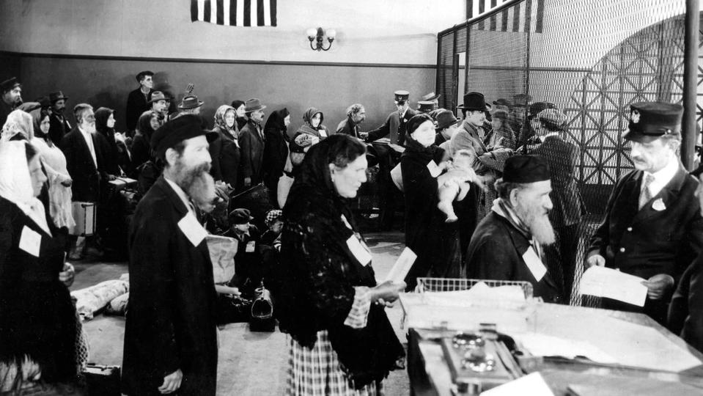

Slide 31
