Slide 1
Hardship and Suffering
A Non-Petraitis Story

Slide 2
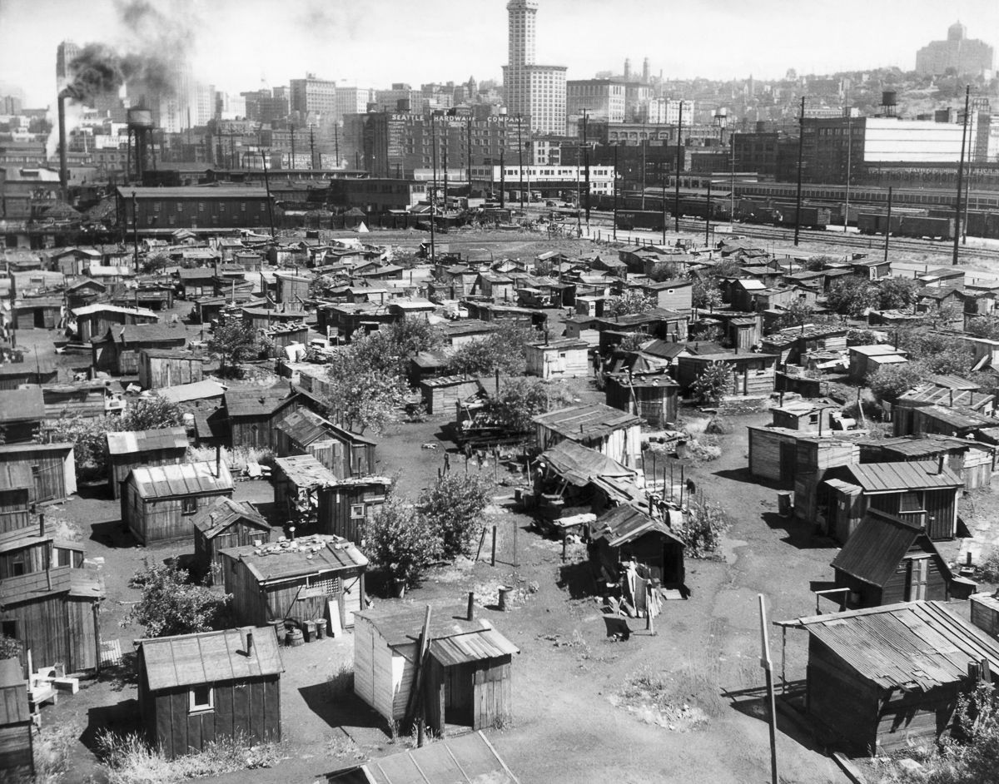
Shantytown

Slide 3
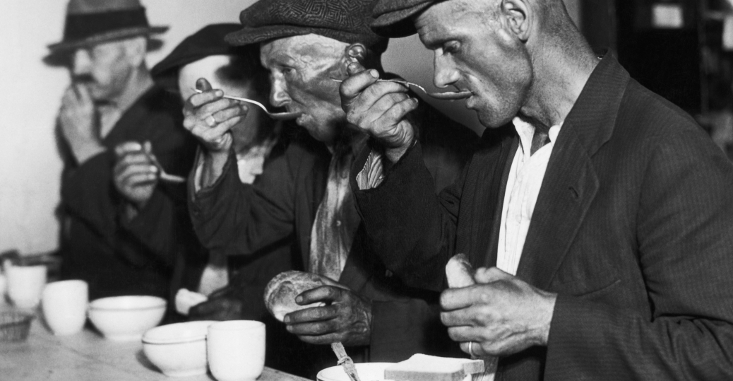
Soup Kitchen

Slide 4
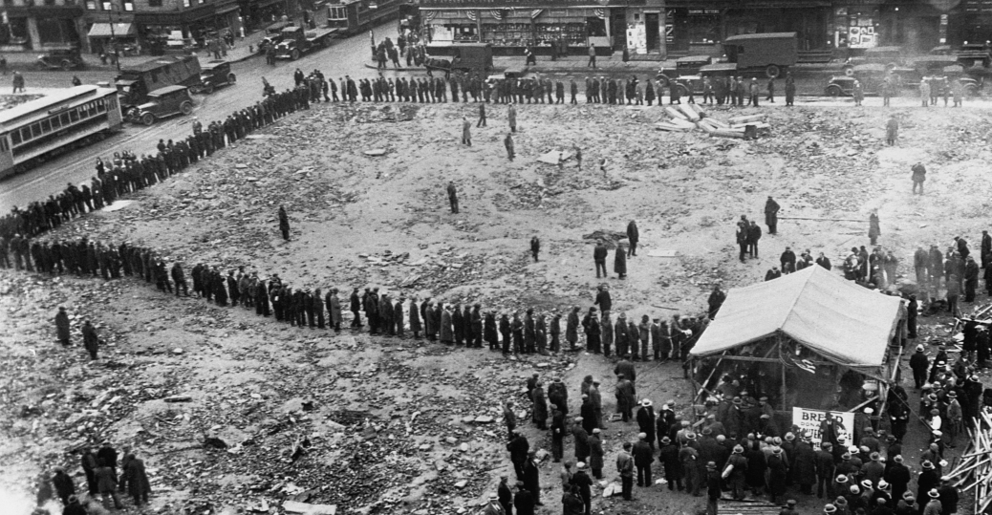
Bread Line

Slide 5
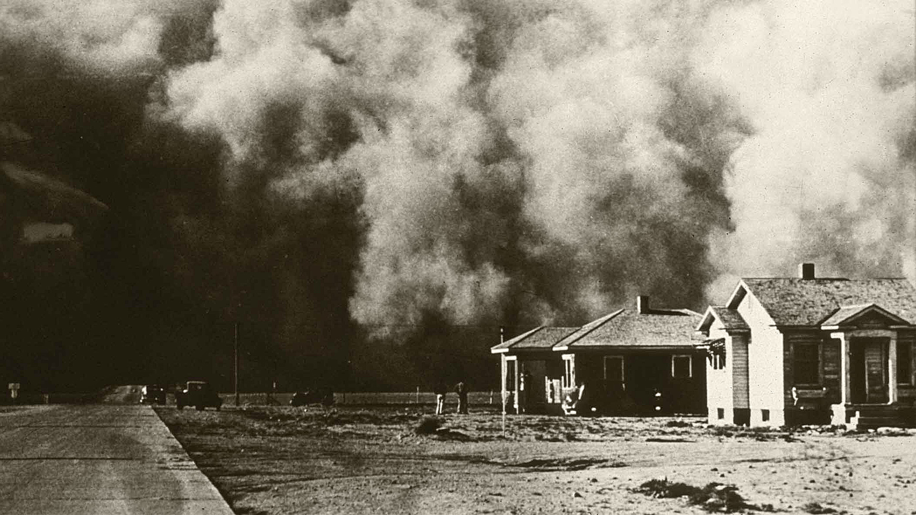
Dust Bowl

Slide 6
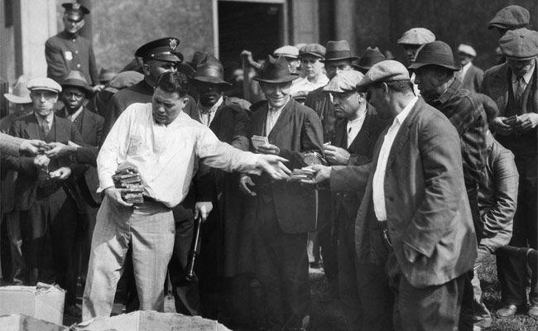
Direct Relief

Slide 7
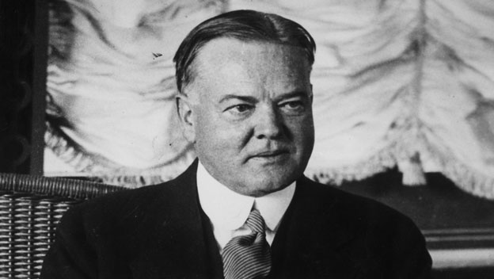
Herbert Hoover

Slide 8
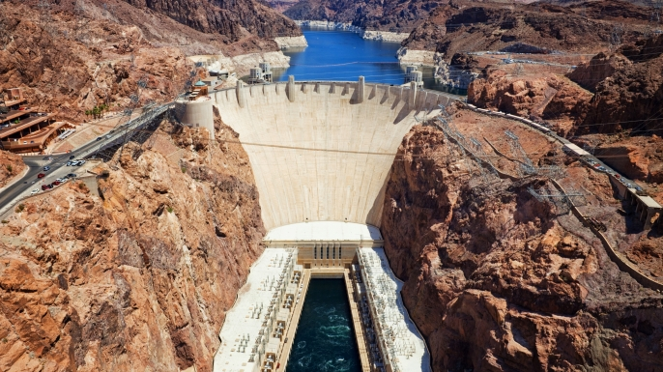
Boulder Dam

Slide 9

Federal Home Loan Bank Act

Slide 10

Reconstruction Finance Corporation

Slide 11
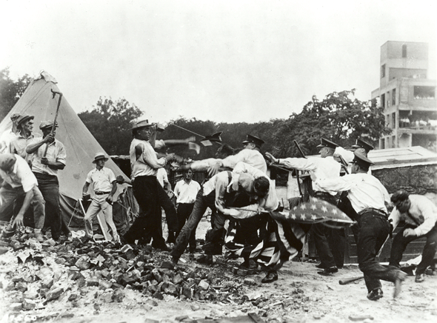
Bonus Army

