Slide 1
Cultures Clash on the Prairie
Westward Expansion or basically…
“Hey Indians! You have some nice stuff. Now we have some nice stuff.”
America, Probably

Slide 2
The Culture of the Plains Indians
Ok, so basically page 117 is a bunch of general bland generalities about the many varied and rich cultures of North America. Basically, Indians lived in tepees, ate buffaloes, fought and were generally misunderstood.
I suppose this is partially true but it seems a little disrespectful to make Indians just a footnote in American History.
For example this unit is called westward expansion. That should say something in itself, but whatever. Ok I wasted a slide. Sorry.

Slide 3
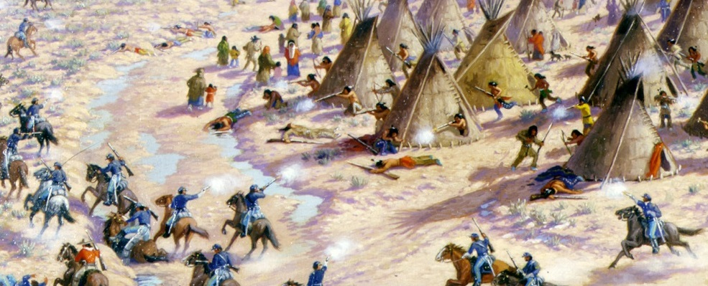
Massacre at Sand Creek
So…in 1864 the Cheyenne Indians were invited to spend the winter at the Sand Creek Reserve in Colorado, with the understanding that they would be protected by the U.S. military.
Instead…General S. R. Curtis sent a telegram to colonel John Chivington suggesting the Indians had not suffered enough.
Chivington basically said “say no more” and attacked the Indian Camp and murdered 150 Indians. This was on November 29, 1864. Mostly women and children were killed.

Slide 4
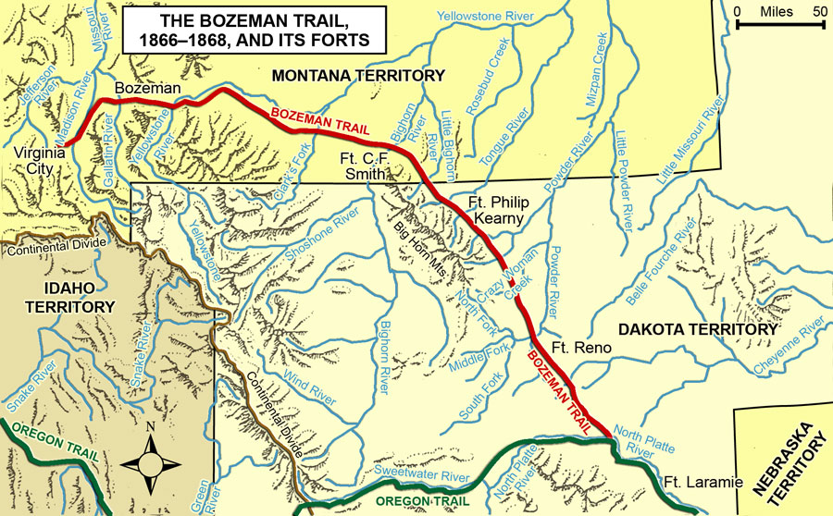
Death on the Bozeman Trail
Ok. Fast forward to 1866. Everyone is a little tense.
The Bozeman trail was a U.S. trail (sort of a road) that went through the Sioux Indian hunting grounds in the Bighorn Mountains in Wyoming.
Red Cloud AKA Mahpiua Luta wanted the Americans to stop using the trail.
Americans did NOT stop using the trail so the Sioux warrior Crazy Horse attacked Captain William J. Fetterman and his soldiers at Lodge Trail Ridge. Over 80 soldiers were killed. The Sioux know this as the Battle of the Hundred Slain. Americans generally refer to this as the Fetterman Massacre.

Slide 5
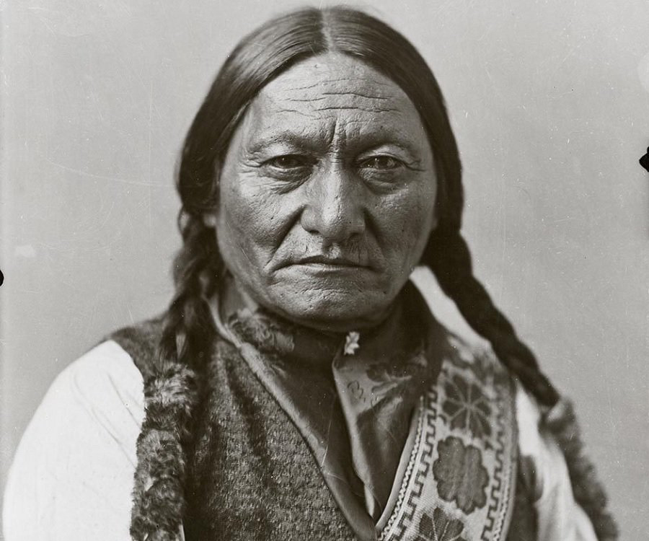
So…
The U.S. government agreed to close the Bozeman trail. But there was a catch.
The U.S. forced the Treaty of Fort Laramie on the Sioux.
This treaty assumed the Sioux would agree to live on a Reservation along the Missouri River. This was in 1868.
However Sitting Bull AKA Tatanka Iyotanka, leader of the Hunkpapa Sioux never signed the treaty. The Ogala and Brule Sioux DID sign, but they expected to be able to continue to hunt on their traditional hunting grounds.

Slide 6
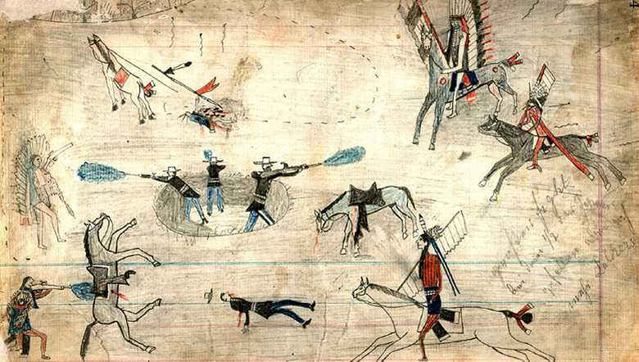
The Red River War
So the Treaty of Fort Laramie chilled everyone out for a while.
BUT THEN…
In 1868 (again) the Kiowa and the Comanche started raiding U.S. properties. This led to the Red River War of 1874-1875.
All of the friendly nations were forced onto reservations.
General Philip Sheridan gave orders to kill all of the Indians AND their horses. He also ordered all women and children to be captured. He is known for this quote “The only good Indian is a dead Indian”.
Fun fact! Sheridan street in Hollywood is named for General Sheridan. It just happens to run RIGHT THROUGH THE MIDDLE OF THE SEMINOLE RESERVATION. This seems like a pretty big F U to the Indians, but it might just be a coincidence.

Slide 7
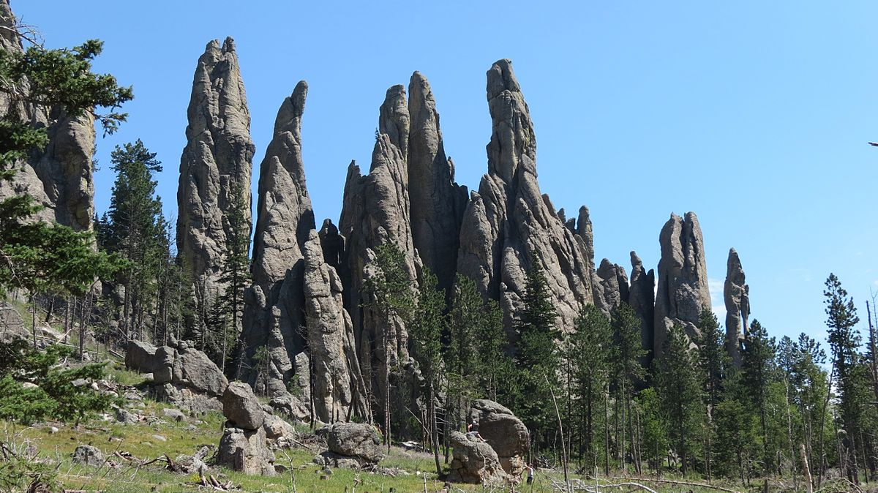
Again…
So there is this piece of land (The Black Hills of South Dakota) that was (is) considered to be sacred to the Sioux, the Cheyenne, and the Arapaho. The U.S. agreed to leave this area alone. But then…
GOLD!
So now the U.S. government wanted it back.
So they sent General George Custer, who by all accounts was a bit of a dick to kick them out of the Black Hills.
Anyways…In early June of 1876 the Sioux and Cheyenne held a Sun Dance. We will pause here for a minute while the two students seated closest to me demonstrate what this probably looked like.

Slide 8
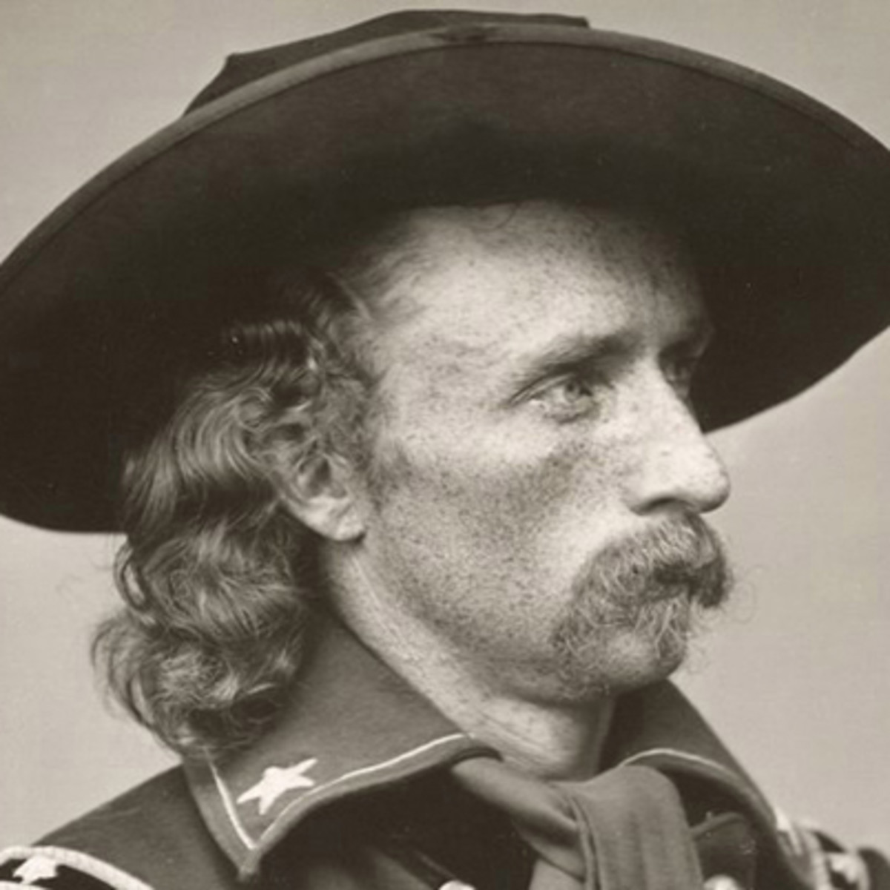
Thanks. And now…
During the aforementioned Sundance) Sitting Bull had a vision of soldiers falling off their horses.
When Custer and his 600 soldiers reached the Little Bighorn River they found an encampment of mostly women and children and said…(probably) “if you can’t beat a bunch of women and children, who can you beat? Come on let’s go murder some younglings!”
-General George Armstrong Custer, Probably
However he failed to notice the 10,000 warriors hiding behind the hill in front of him. So he never really had much of a chance to murder all the people he wanted to.

Slide 9
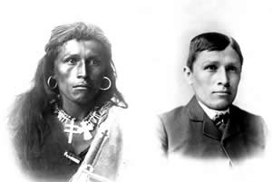
So. What to do about the Indians?
Well, how about we encourage them to give up everything they ever knew and convince them to take up a lifestyle more in line with what Americans thought was acceptable.
This did not go over too well.
I present to you: “The Carlisle Indian Industrial School”
Not all Americans thought this was ok. For example Helen Hunt Jackson that wrote the book, A Century of Dishonor.
Oh, then we had a great plan! The Indians ate mostly buffalo (bison). What if we murdered all of the bison? That should get the Indians in line! Here’s what that looked like…

Slide 10
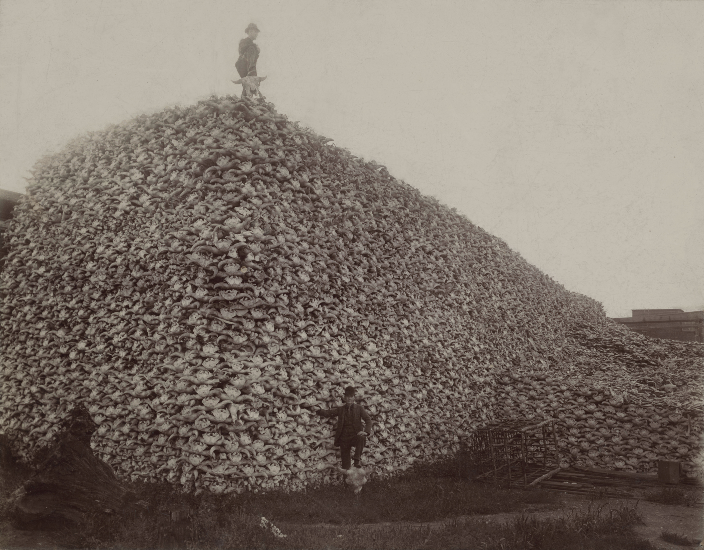

Slide 11
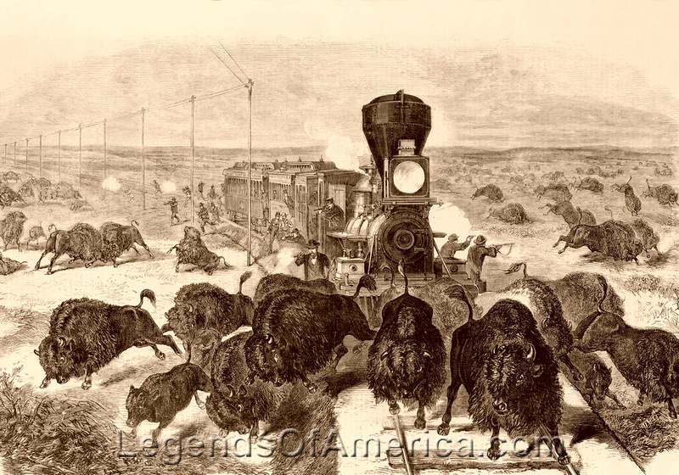

Slide 12
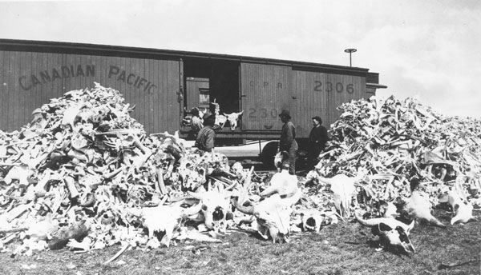

Slide 13
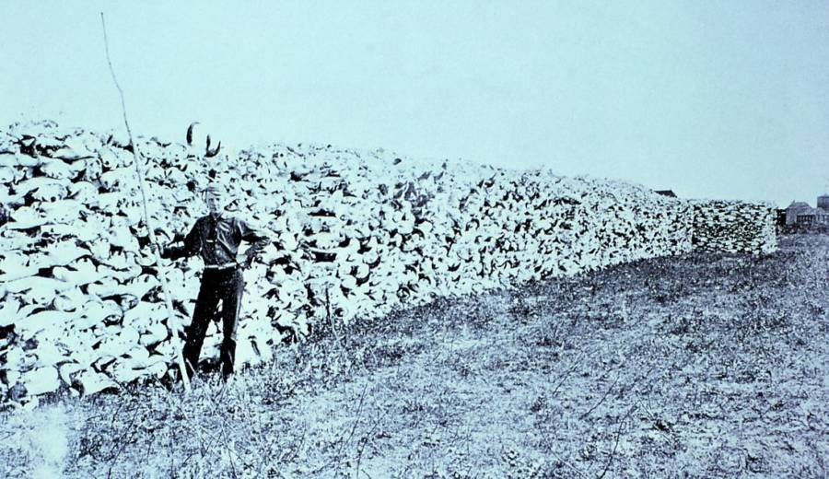

Slide 14
So the whole buffalo thing worked out pretty well for the U.S. government
So now…The Dawes Act
Basically we give the Indians a reservation.
Then we tell them we expect each family to live on an American style farm.
Then…we take all the land that is not a farm and sell it to other Americans.
Basically, become a farmer or don’t. But if you don’t you will have nowhere to hunt.

Slide 15
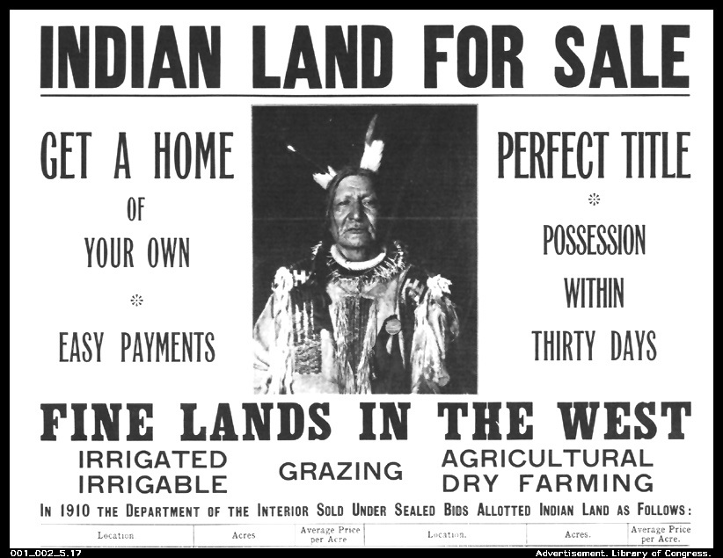

Slide 16
The Battle of Wounded Knee
This all started with a dance. Once again the two students closest to me will demonstrate this.
The ghost dance was a threat because it emboldened Indians and united various tribes.
Sitting Bull was the dude behind most of this dancing so the U.S. government ordered his arrest. 40 native American police were sent to get him, but his friend Catch-the Bear shot one. (This is seriously a cool name, not going to lie.) The police then killed Sitting Bull. So Chief Big Foot took charge and led the Sioux away, attempting to get to Canada.
The fleeing Sioux were captured and taken to Wounded Knee. The Indians were asked to give up their weapons. Someone fired a weapon, and the U.S. army responded by murdering 350 Indians by firing cannons at them. Mostly the Indians killed were children.
This was pretty much the end of Indian resistance.

Slide 17
