Slide 1
The 1920’s
An abbreviated tour. Enjoy.

Slide 2
The 1920’s was full of the following:
Warren G. Harding
Charles Evan Hughes
Fordney-McCumber Tariff
Ohio Gang
Teapot Dome Scandal
Albert B. Fall
Calvin Coolidge
Urban Sprawl
Consumerism
Installment Plan
Xenophobia
Nativism
Isolationism
Communism
Anarchists
Sacco and Vanzetti
Quota System
John J. Lewis
Prohibition
Speakeasy
Bootlegger
Fundamentalism
Clarence Darrow
Scopes Trial
Kellogg-Briand Pact

Slide 3
Learn all of the previous…
P.E.R.S.I.A. that. Due first day next week. Make sure you include the definitions.
Pages:
360
370
379

Slide 4
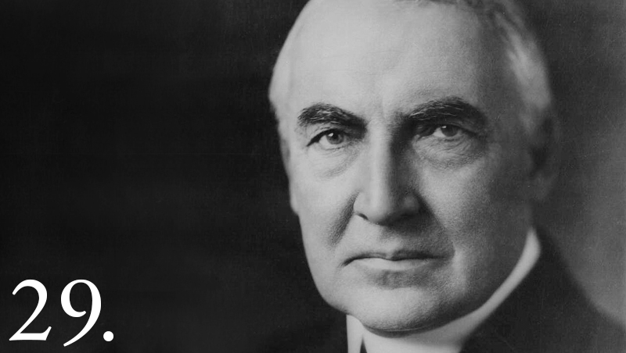

Slide 5
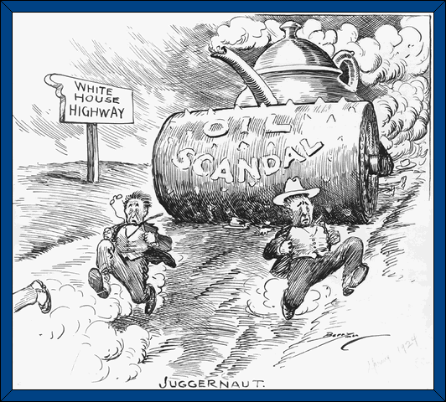

Slide 6
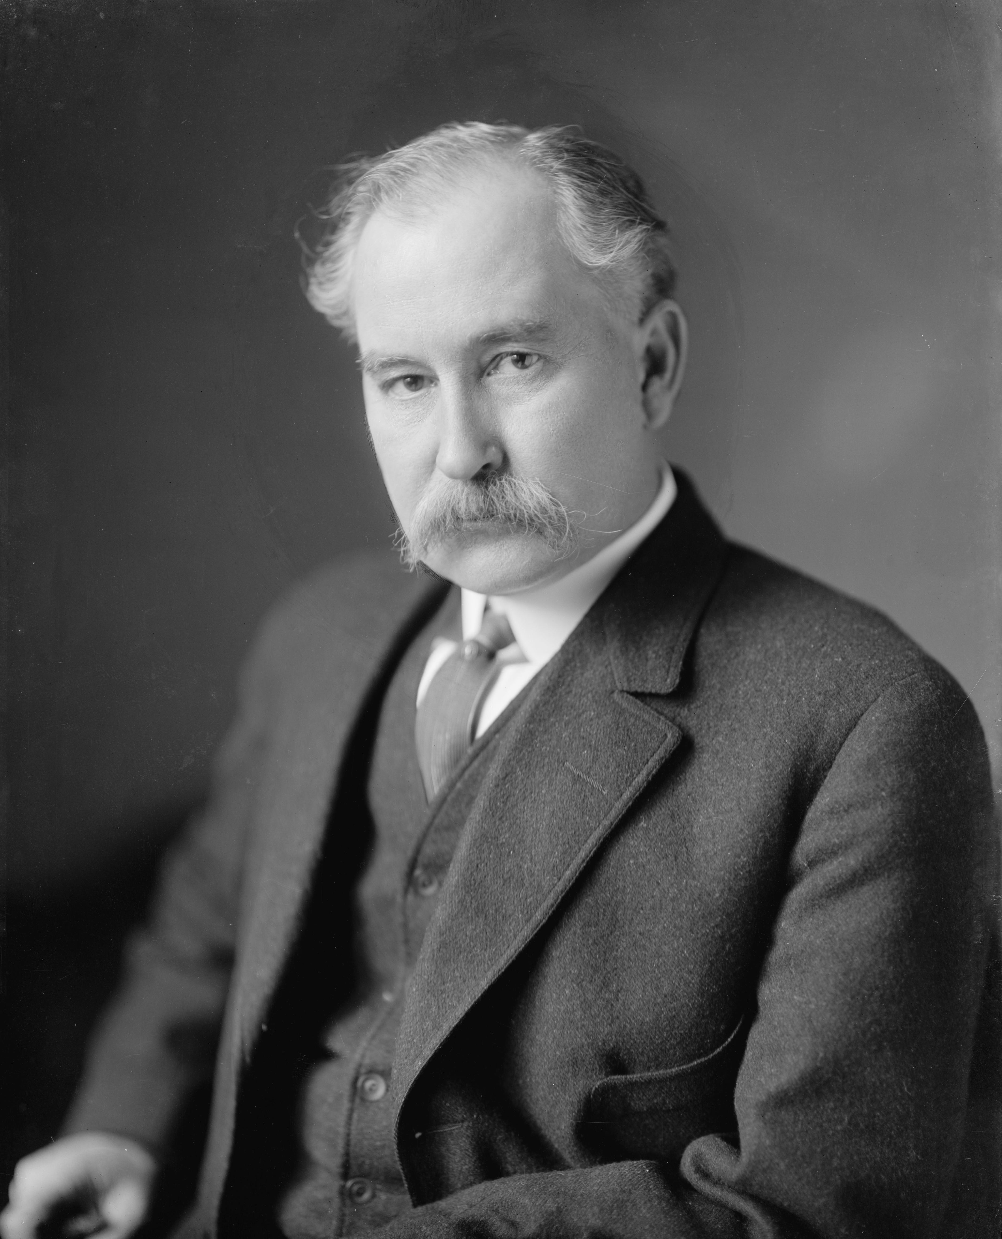

Slide 7
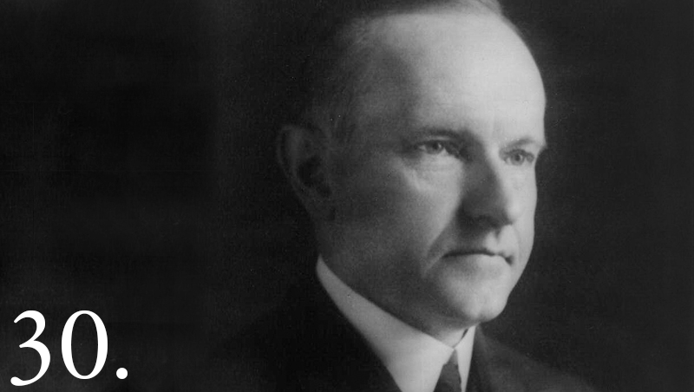

Slide 8
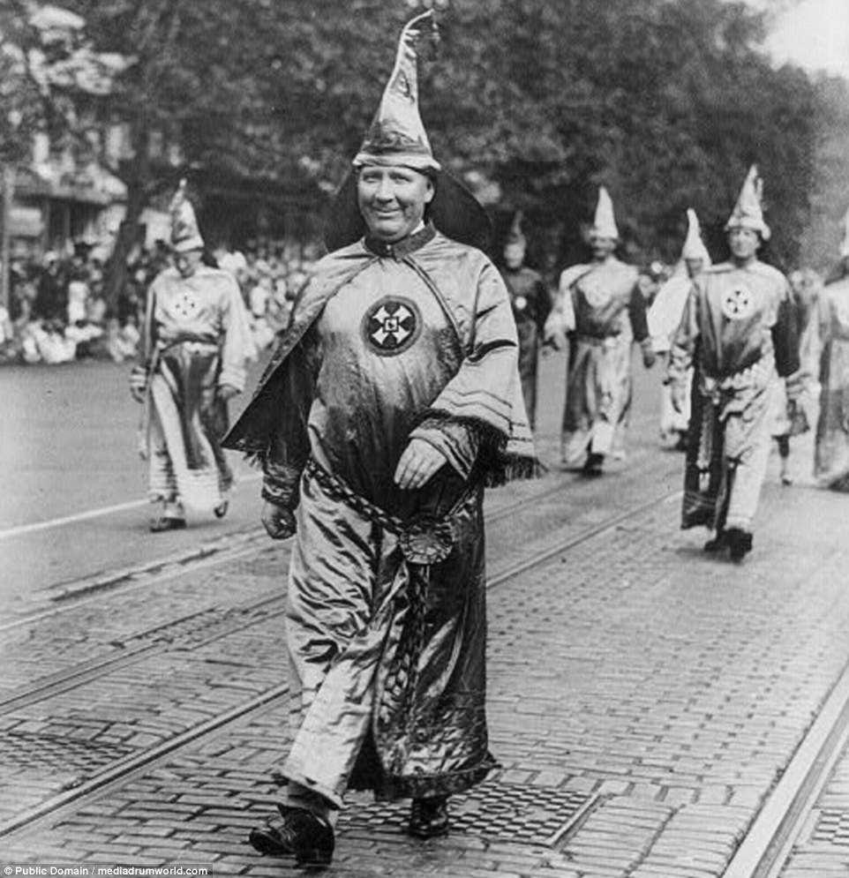

Slide 9
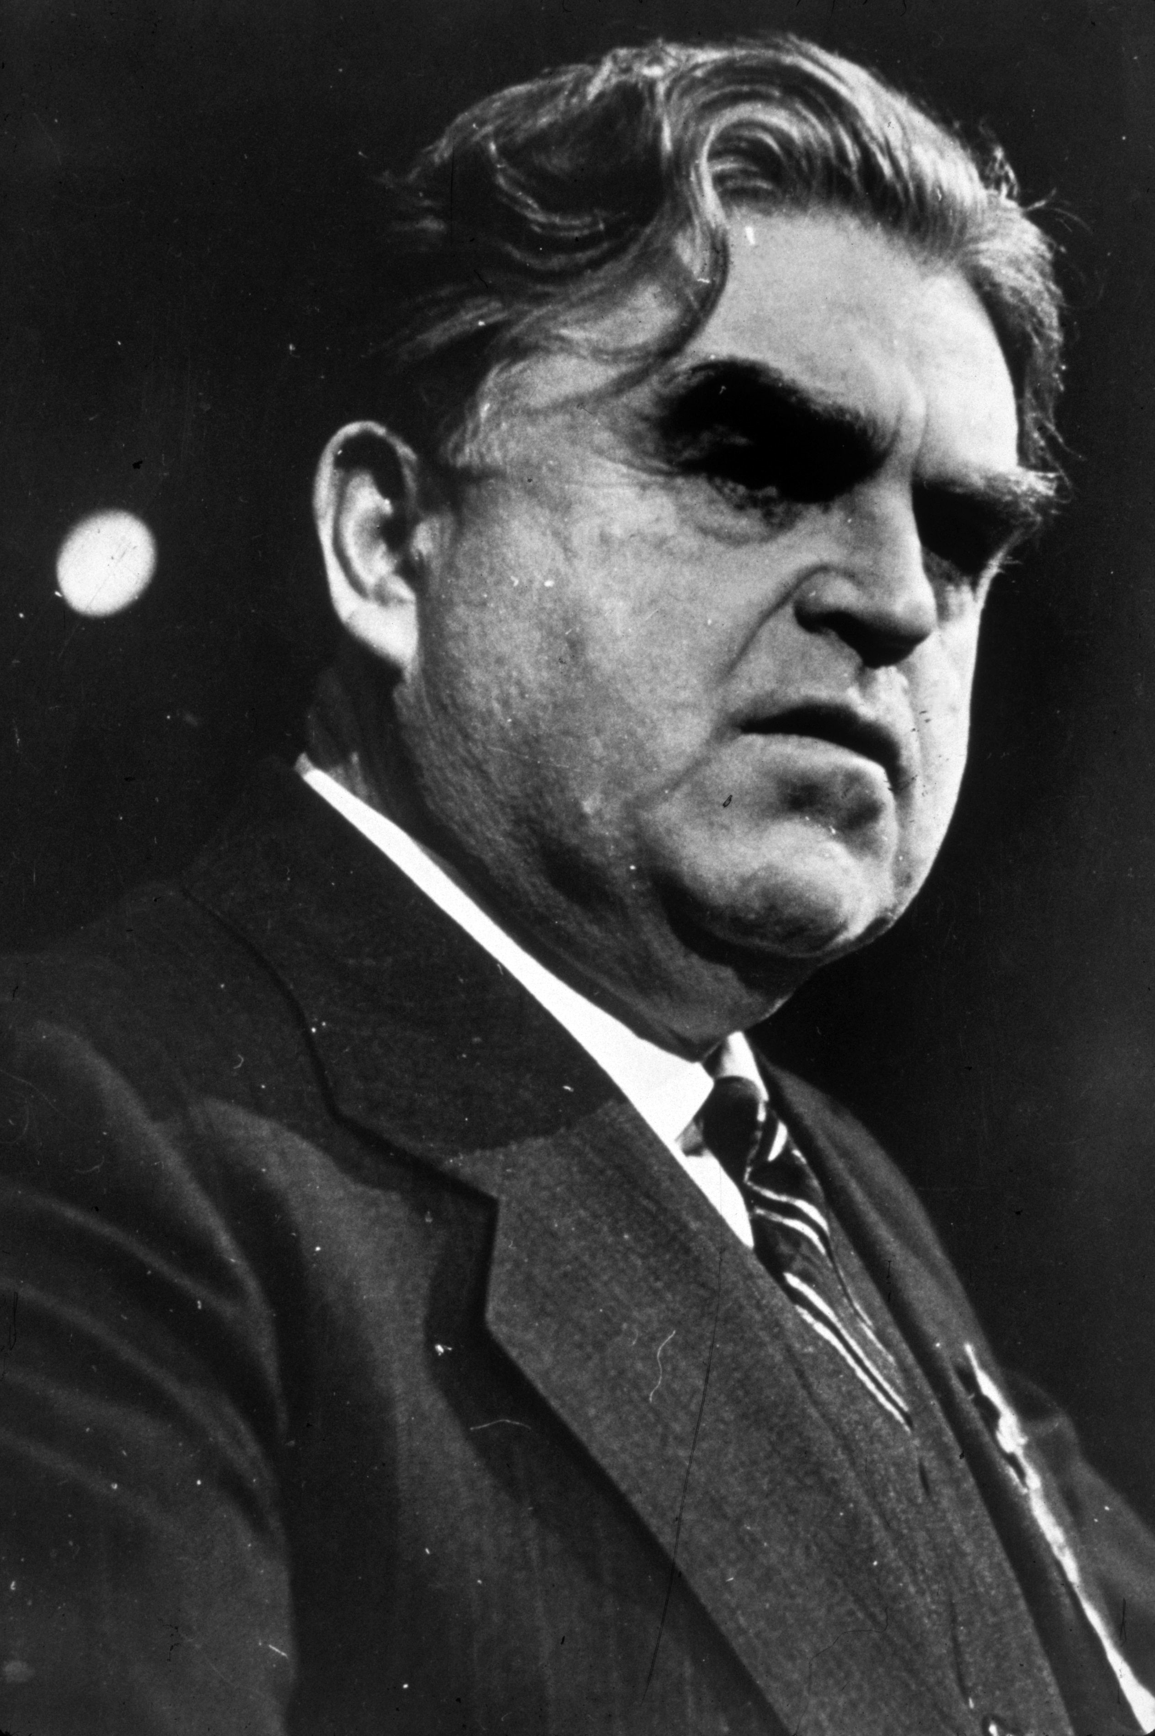

Slide 10
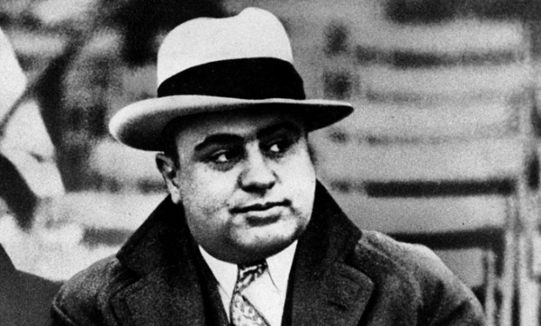

Slide 11
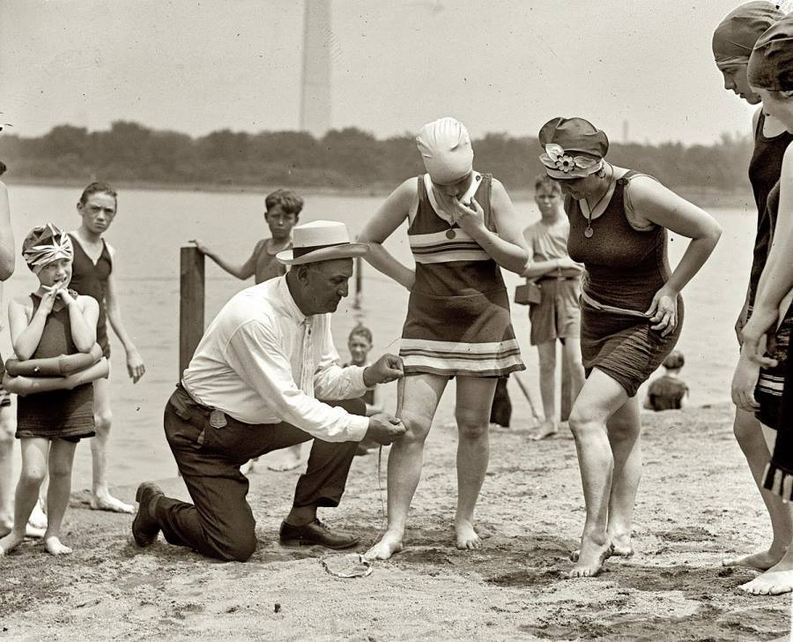

Slide 12
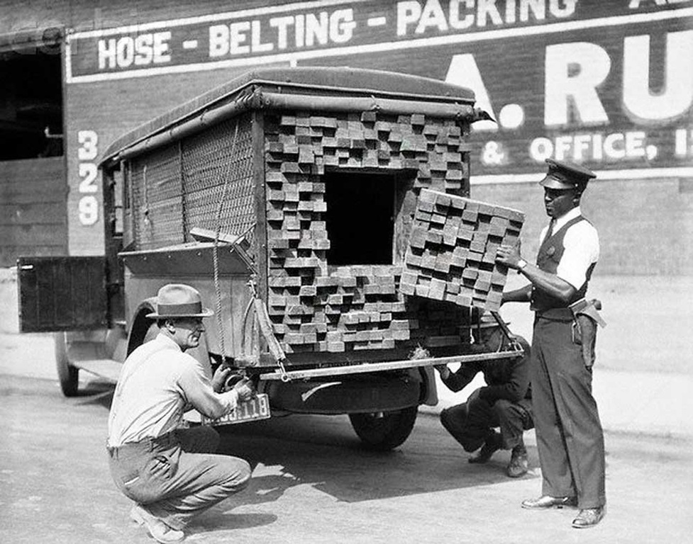

Slide 13
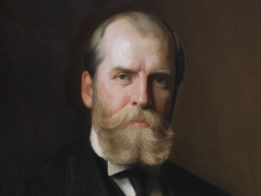

Slide 14
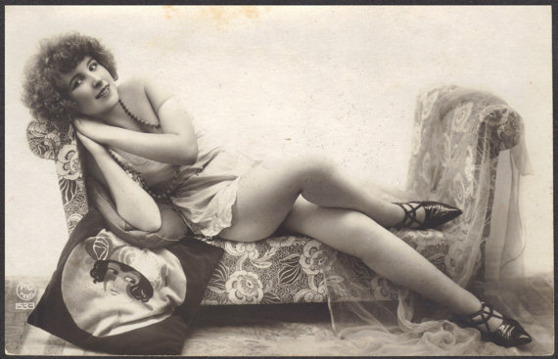

Slide 15
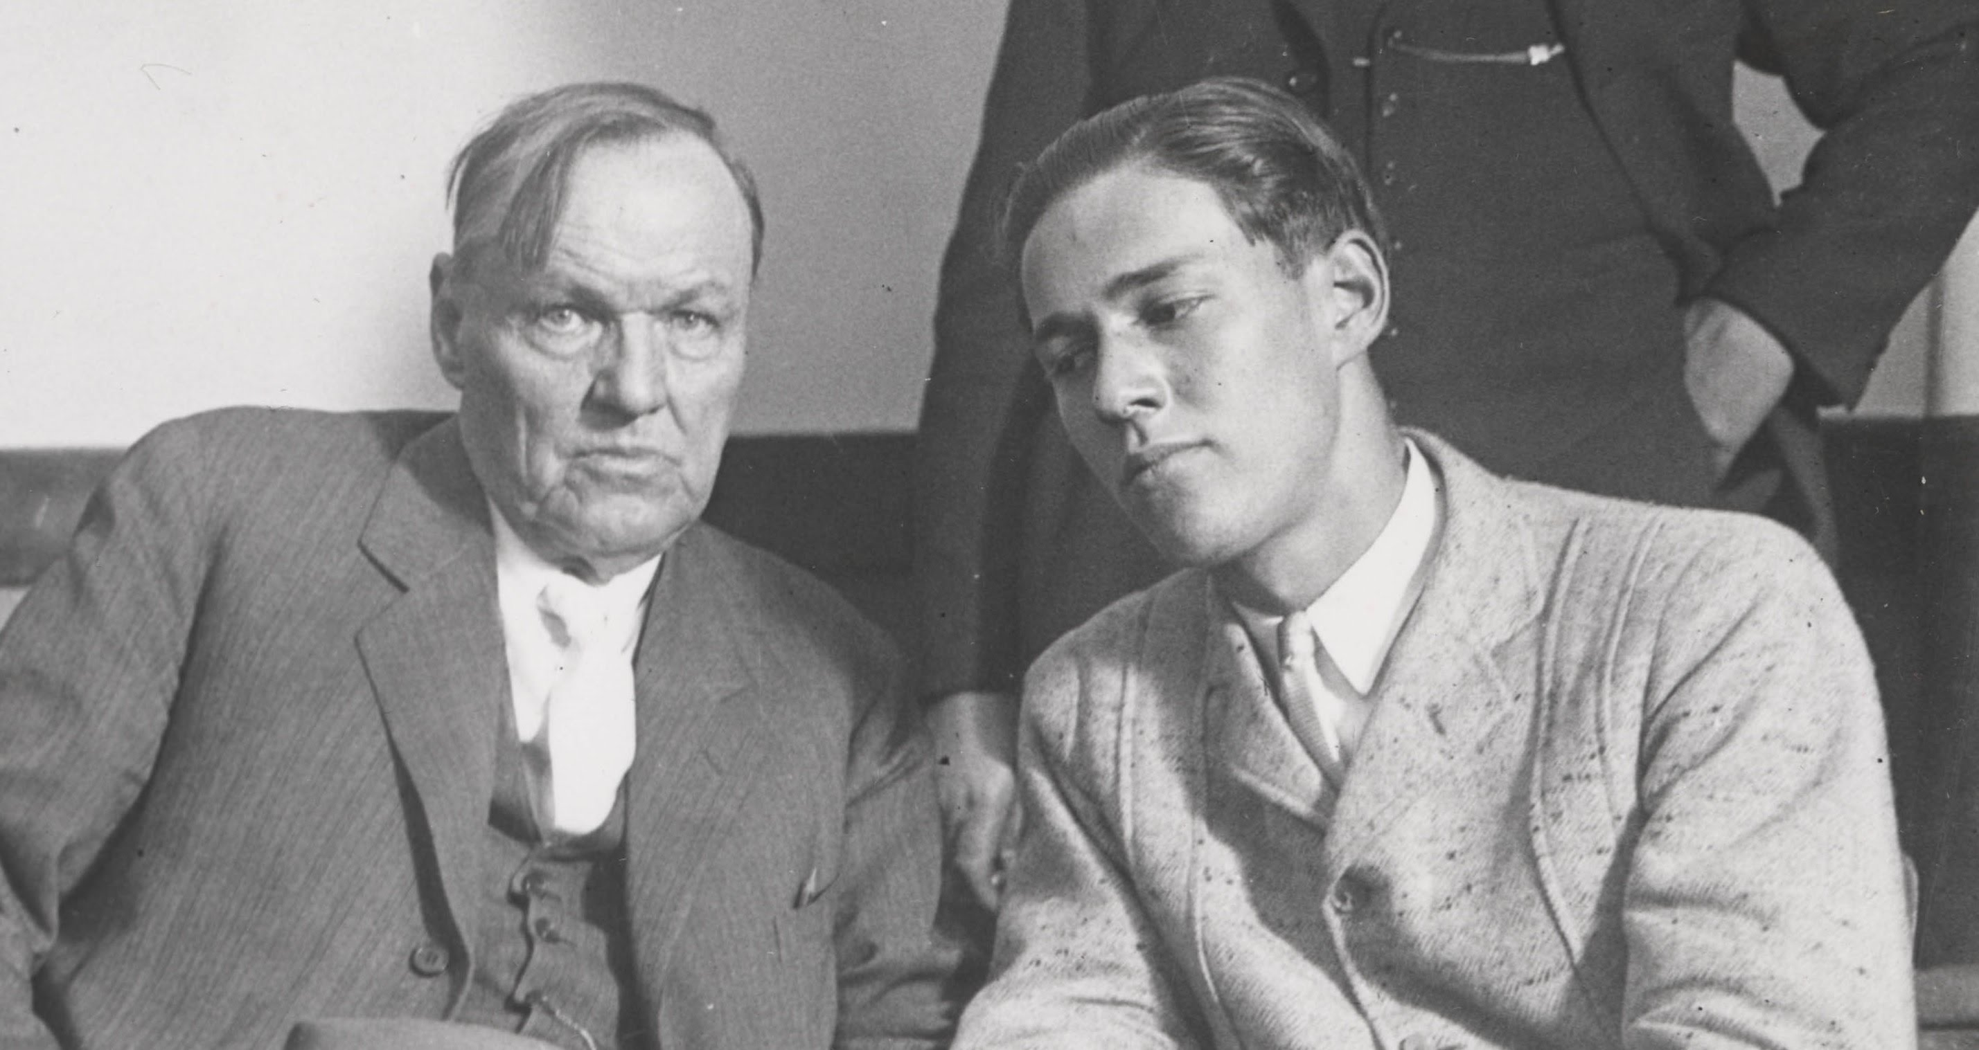

Slide 16
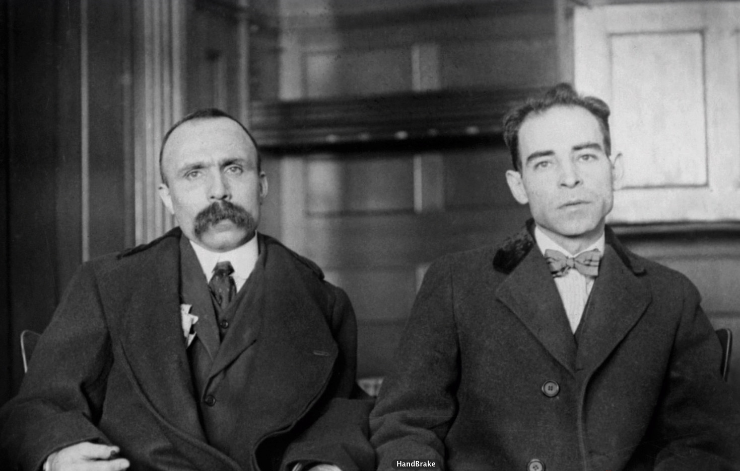

Slide 17
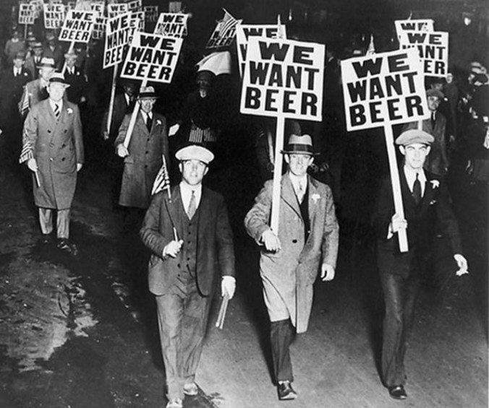

Slide 18
