Slide 1
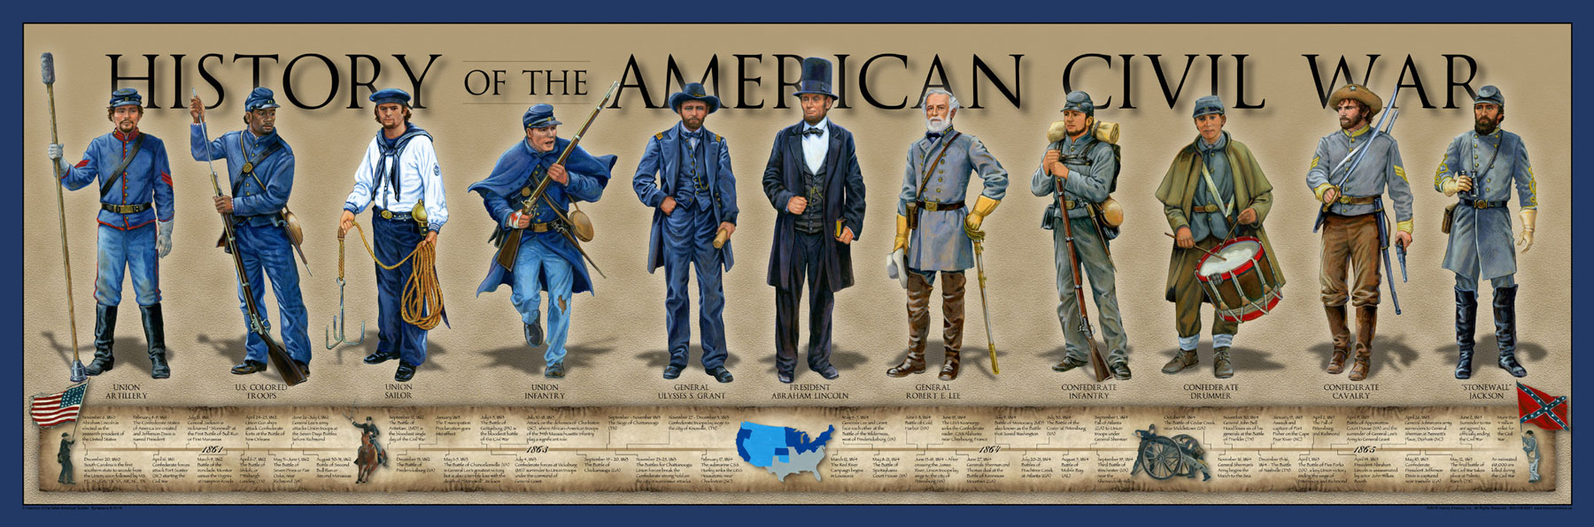
The Course and Consequences of the Civil War

Slide 3
The Anaconda Plan
https://www.youtube.com/watch?v=6VxV717PRBU

Slide 4
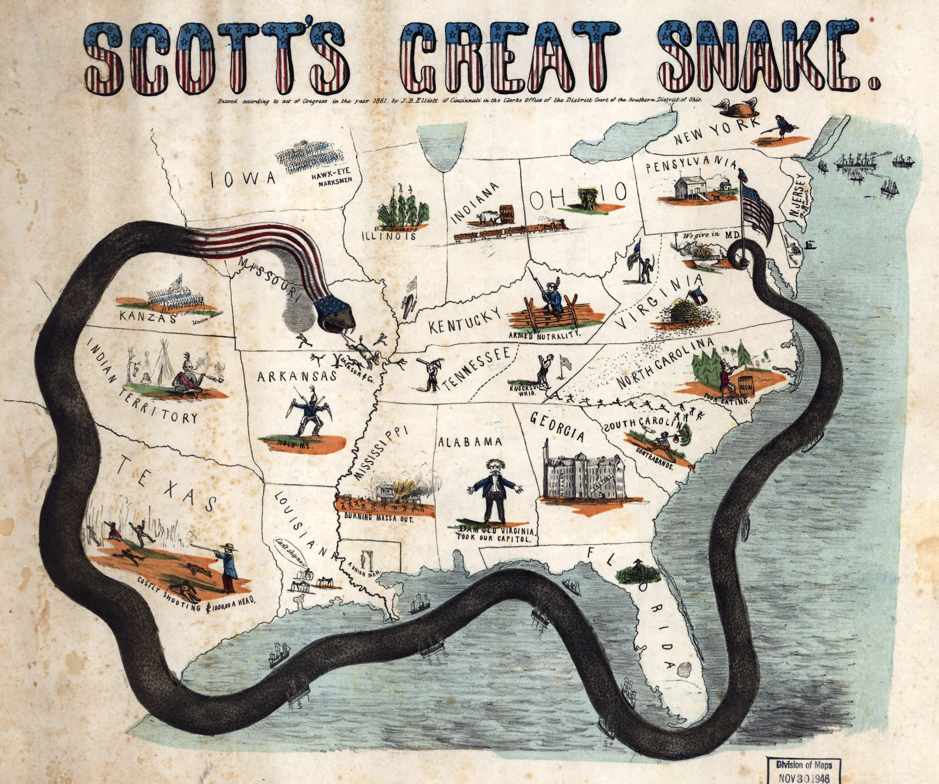
OK the REAL Anaconda plan.
So, as you just found out, the anaconda is a giant snake.
This was a plan suggested by Winfield Scott.
Basically strangle the south. No cotton out and no supplies in.

Slide 6
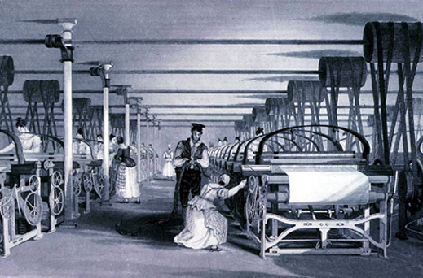
Britain and the potential allies of the South
The South although fighting for the right to keep slavery (or as they imagined, the right to do whatever.)
Britain was pretty dependent on cotton.
The South assumed that if there was not cotton, (Anaconda Plan) then Britain would enter the war on the side of the South. HOWEVER…most of the average British Citizens didn’t agree with slavery.
Enter the….wait for it….

Slide 7
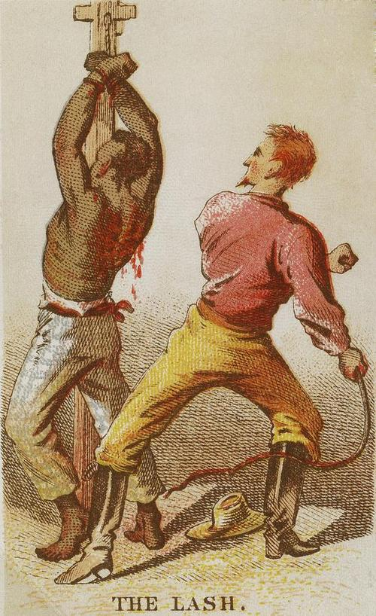
The Emancipation Proclamation!
President Lincoln was reluctant to admit the war was about slavery because…
If he admitted the war was about slavery then he would lose the support of the border states. (Missouri, Kentucky, Maryland and Delaware.) Slavery was legal in those states.
After the Battle of Antietam (one of the bloodiest of the war and a Northern Victory) Lincoln felt confident enough to announce the Emancipation Proclamation on September 22, 1862.
The Emancipation was not completely binding, considering it only existed in places where the Union had no power. However…

Slide 8
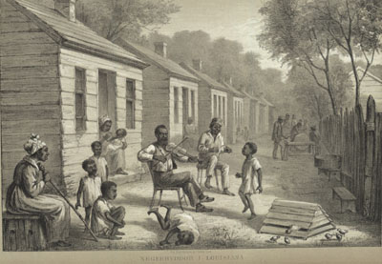
The Effects of the Emancipation Proclamation
Britain could not really enter the war on the side of the Confederacy without looking like they were supporting slavery.
Slaves that heard about the Emancipation Proclamation started to think about leaving the plantations.
Slave owners began to get paranoid that there would be a slave revolt and many of them returned home from the war to keep their families safe.
It was a psychological victory. But awesome.

Slide 9
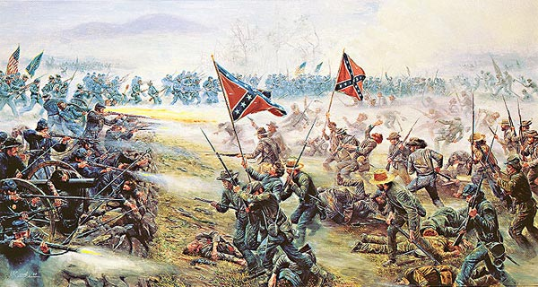
Gettysburg Address
Don’t worry…you’ll be reading that in detail…

Slide 10
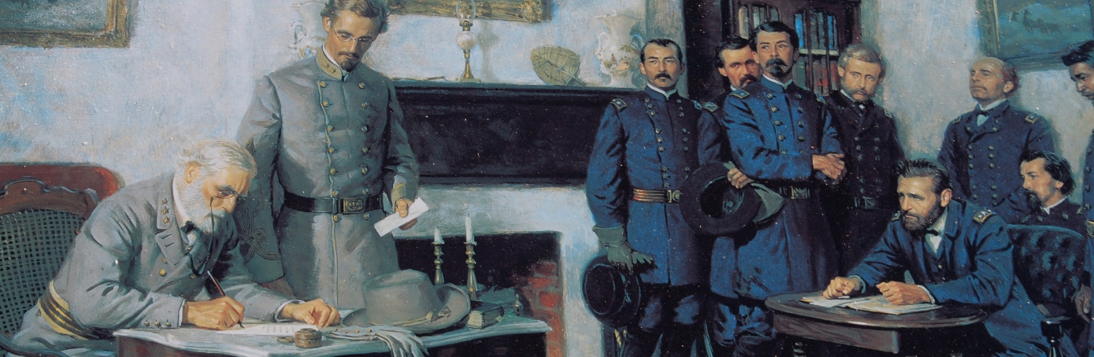
Last Year of the Civil War
Sherman’s March to the Sea
Battle of Gettysburg
Siege of Vicksburg
Appomattox

