Slide 1
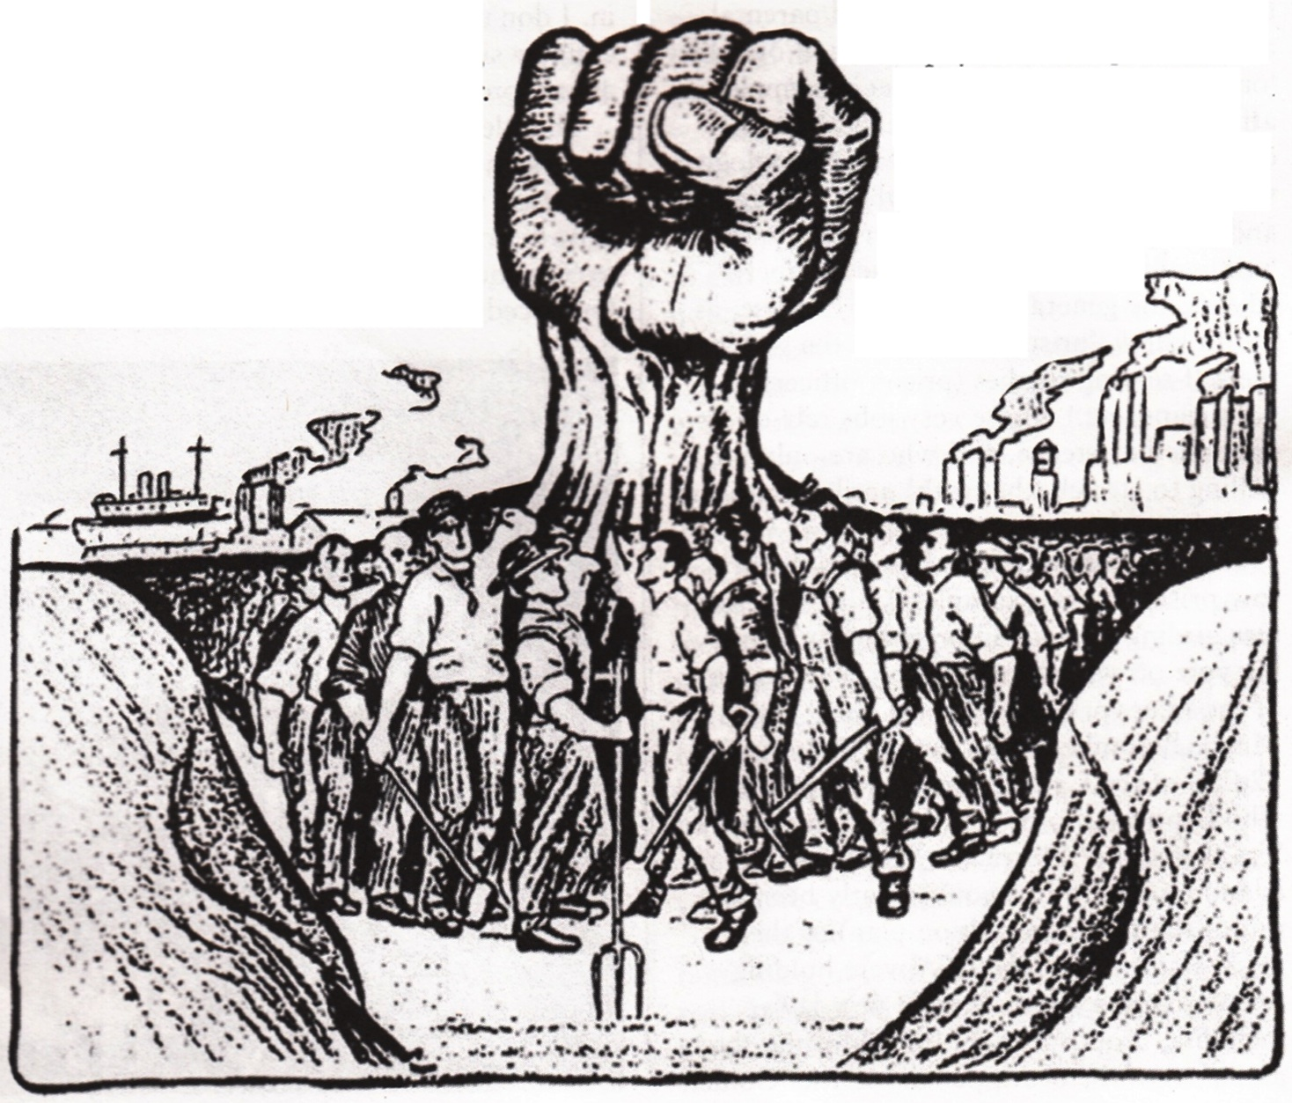
THE RISE OF THE LABOR MOVEMENT!

Slide 2
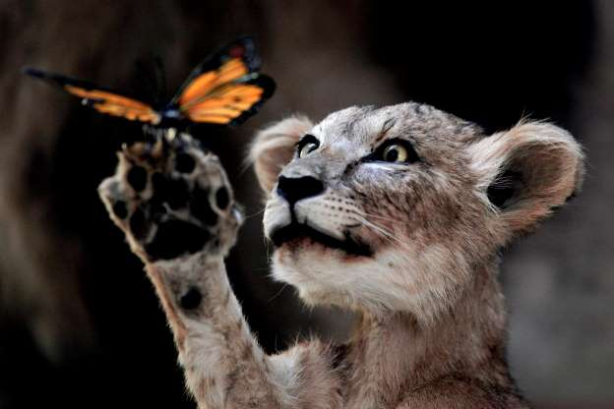

Slide 3
Labor Unions Emerge
So a trust is sort of a “union” of businesses. If businesses can unify, perhaps so can the workers.
Steel mills often expected a worker to work seven days a week.
Seamstresses worked 12 hours or more a day with just one day off.
Employees were not entitled to vacation, sick leave, unemployment compensation, or reimbursement for injuries.

Slide 4
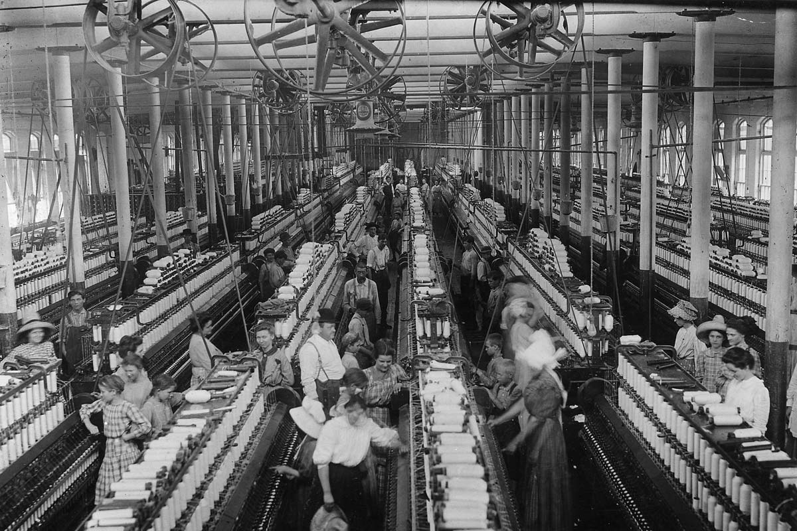

Slide 5
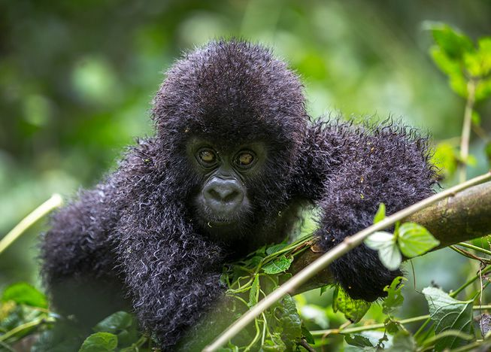

Slide 6
Labor Unions…(still emerging)
Injuries, though not compensated were common.
In 1882 an average of 675 laborers were killed in work related accidents each week.
Also, because of low wages most families needed the ENTIRE family to work to survive. (Yes! Even the pets. A hamster was paid fifty cents a week to sort buttons, and parrots often worked as telephone operators.)
Between 1890 and 1910 the number of women working for wages doubled from four million to 8 million and twenty percent of the girls under 15 also held fulltime jobs.

Slide 7
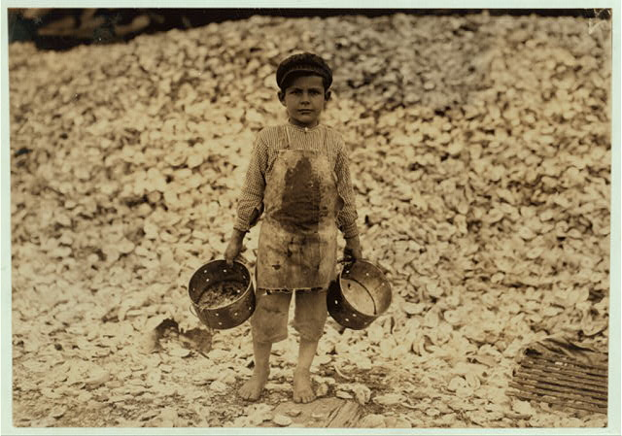

Slide 8


Slide 9
Early Labor Organizing
The National Labor Union (NLU) was formed in 1866 by ironworkers. This was a union for skilled workers.
Not surprisingly everyone you will ever learn about was apparently racist and so of course there needed to be a Colored National Labor Union.
The NLU was successful in securing an eight hour day for government workers.
In 1869 the Noble Order of the Knights of Labor was formed. This was a much more inclusive union and also supported an eight hour day. Also they supported equal pay for equal work, which was pretty radical for the time, because you know…racism.

Slide 10
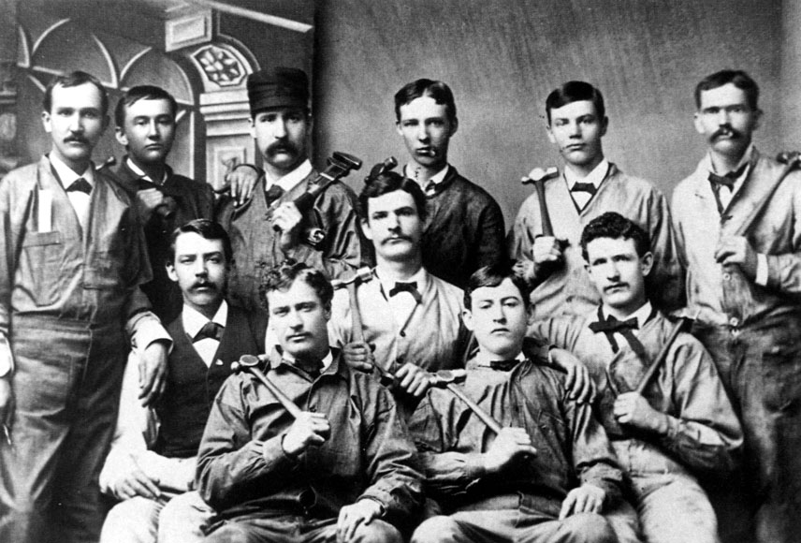

Slide 11
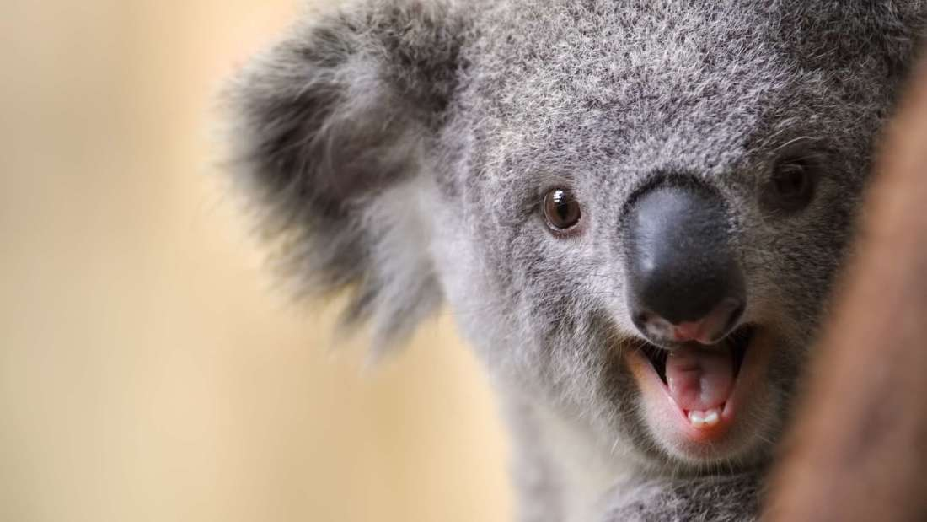

Slide 12
Union Movement Diverge
Craft Unionism
Skilled
American Federation of Labor-Samuel Gompers
Industrial Unionism
Skilled and Unskilled
American Railway Union-Eugene Debs
  Excluded black workers, mix of skilled and unskilled
Socialism and the IWW (Industrial Workers of the World)-Bill Haywood
  Welcomed Black workers, skilled and unskilled workers

Slide 13
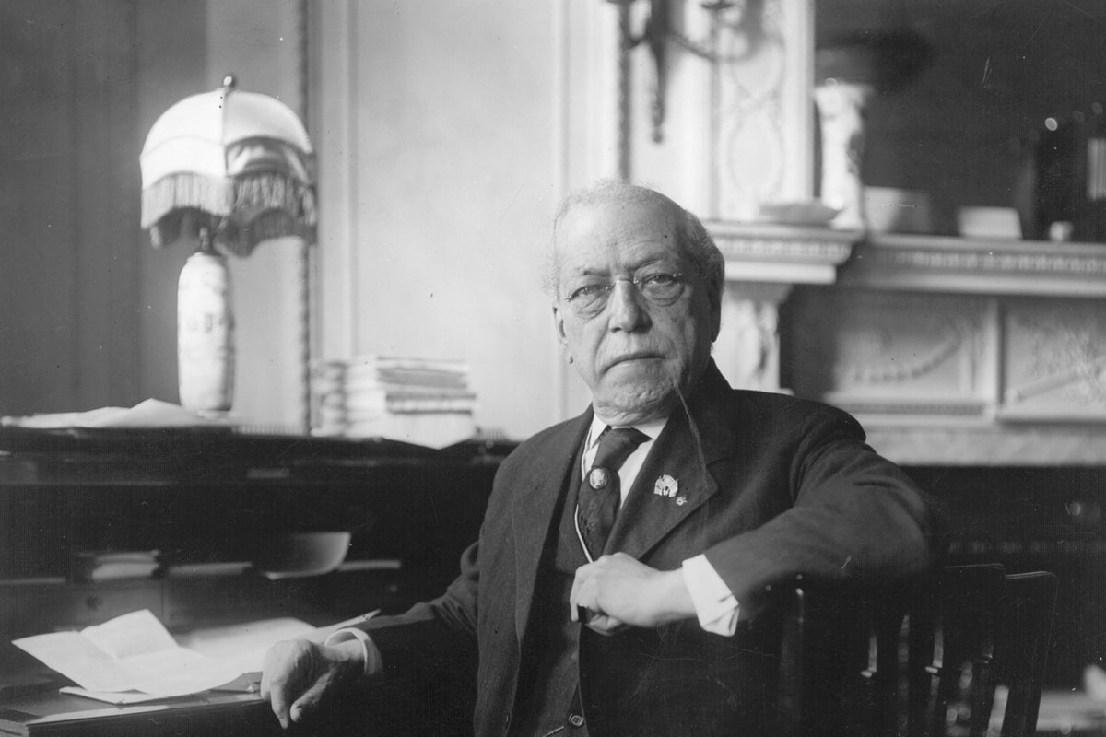

Slide 14
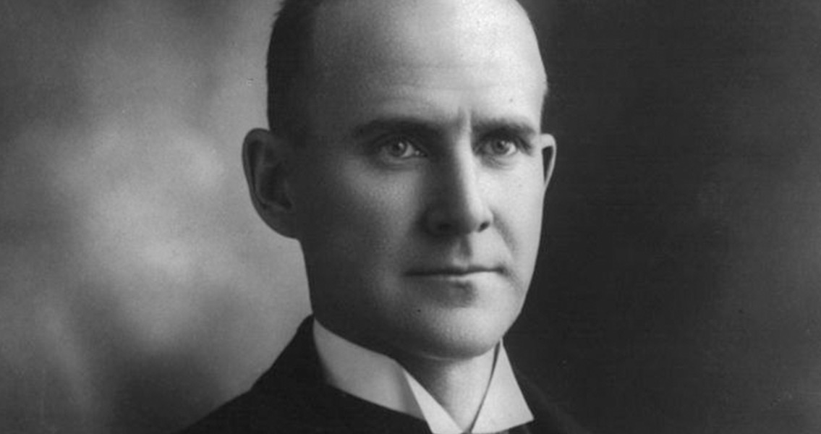

Slide 15
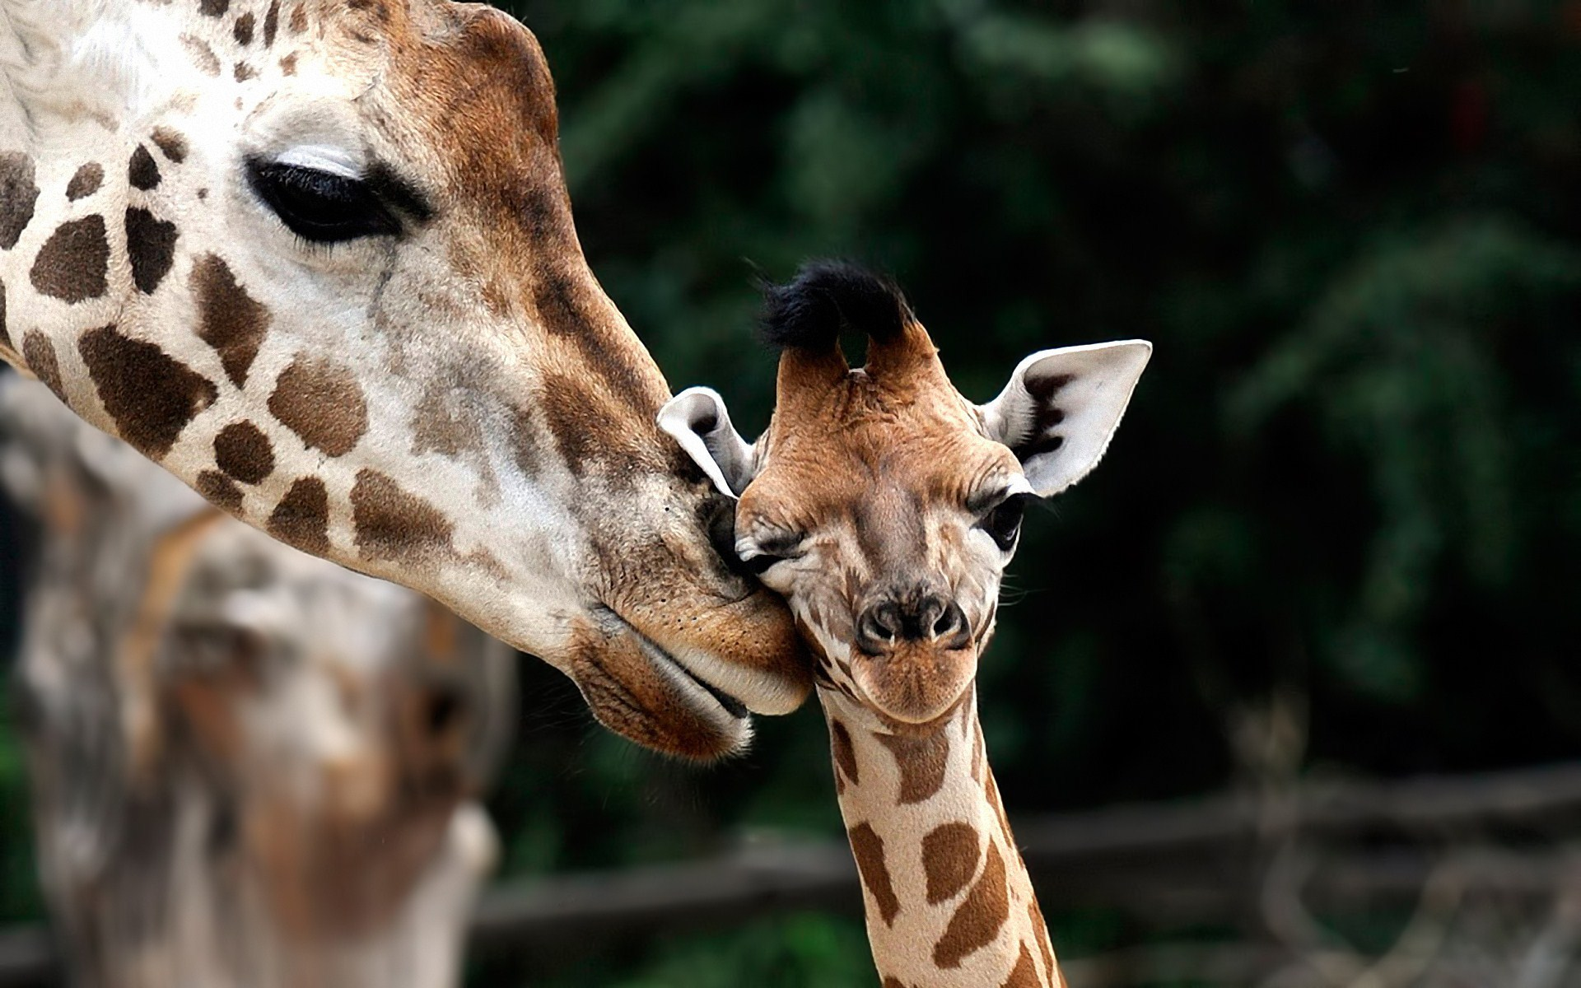

Slide 16
The Great Strike of 1877
Workers for the Baltimore and Ohio Railroad strike to protest their second wage cut in two months.
The strike spreads to other rail lines and eventually over 50,000 miles of rails are closed.
Eventually President Rutherford B. Hayes intervenes and federal troops end the strike.

Slide 17
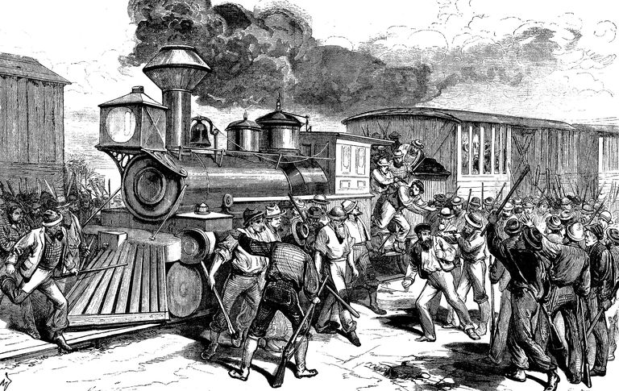

Slide 18
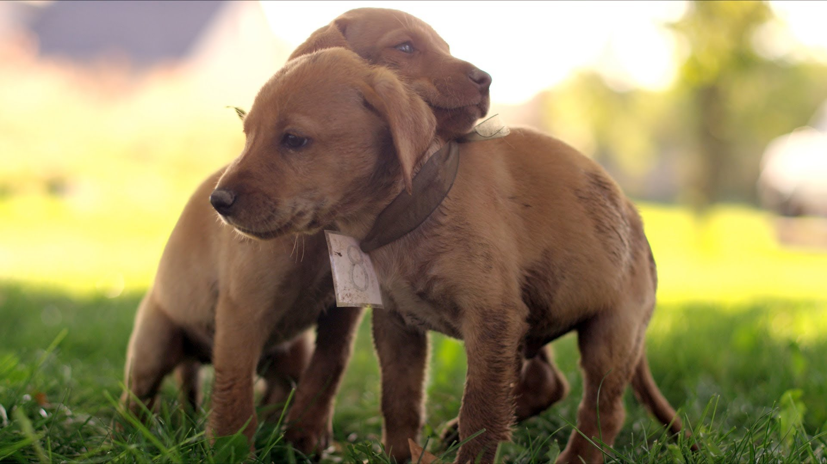

Slide 19
The Haymarket Affair
Encouraged by the Great Strike of 1877 labor leaders continue to press for change.
May 4th 1886 3000 people gather at Haymarket Square in Chicago to protest police brutality.
The day before a worker had been killed and several wounded while on strike at the McCormick Harvester plant.
At around 10 pm the crowd began to disperse and the police arrived.
Someone tossed a bomb into the police line and police fired back at the workers. When it was over seven police officers and several workers were dead.
Three speakers, and five other radicals are charged with inciting a riot. 4 are hanged, one commits suicide and the surviving 3 are pardoned, however labor unions begin to lose support because of the incident.

Slide 20
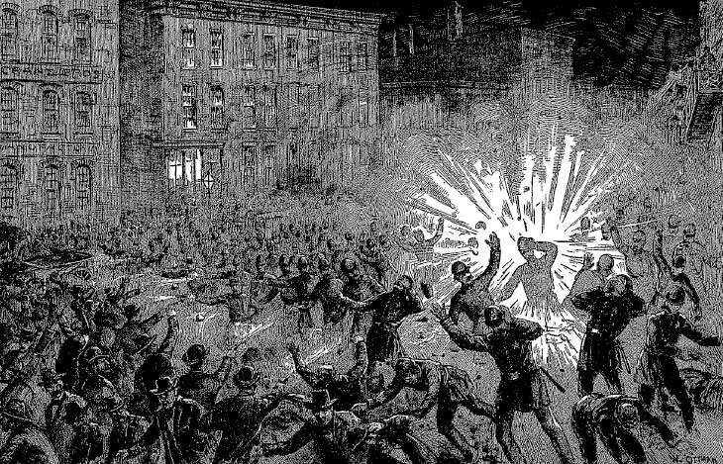

Slide 21
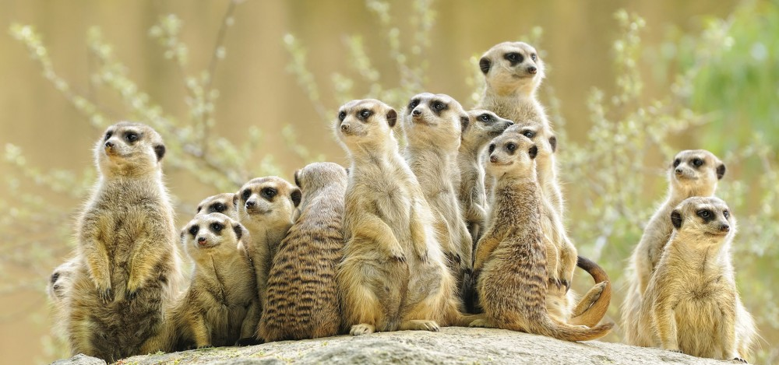

Slide 22
The Homestead Strike
On June 29th 1892, Henry Frick the President of Carnegie Steel Plant in Homestead Pennsylvania announces wage cuts.
Workers call a strike and Frick hires a private police force (the Pinkertons) to protect the plant so he can hire replacement workers.
The workers and the Pinkertons fight leaving three detectives and nine workers dead.
The steelworkers forced out the Pinkertons and kept the plant closed until July 12th. The strike continued until November, but finally the workers gave in and the labor movement is again set back.

Slide 23
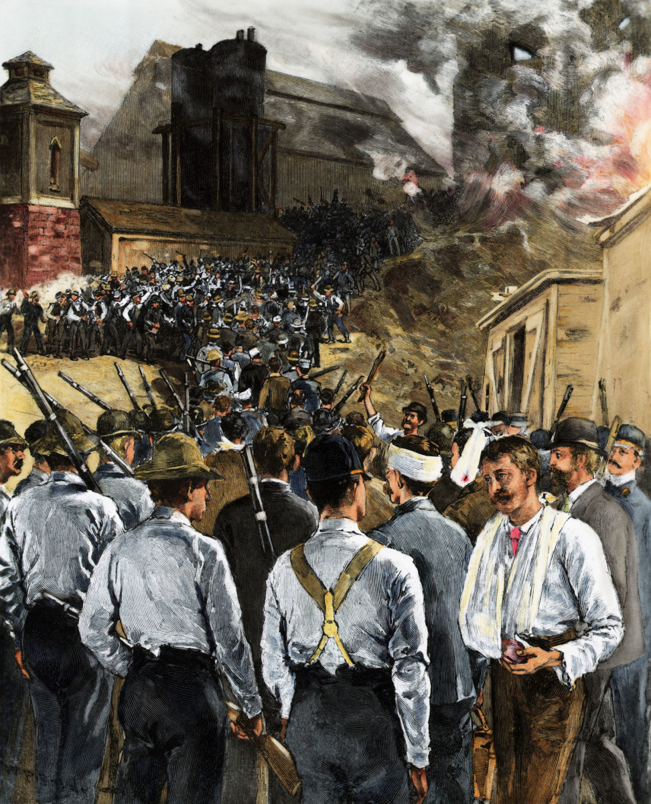

Slide 24
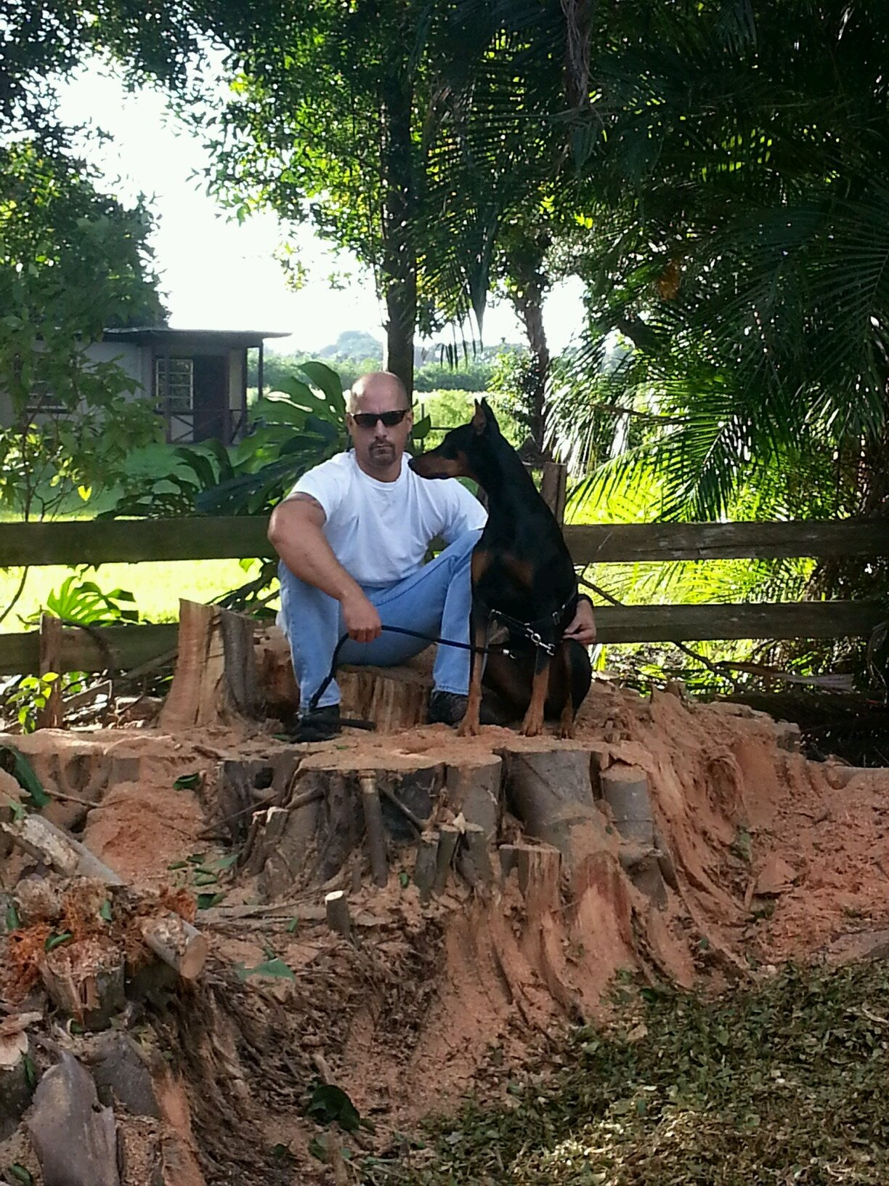

Slide 25
The Pullman Company Strike
During the Panic of 1893 the Pullman Company laid off more that 3,000 of its 5,800 employees.
It cut the wages of the remaining workers by 25 percent to 50 percent.
It DID NOT cut the rent on the company owned houses where the workers lived.
A strike was called in 1894.
The workers demanded higher wages or lower rents, and Eugene Debs tried to arbitrate.
Pullman hired strikebreakers and so the ARU refused to work with Pullman trains. The strike became violent and President Cleveland called in federal troops.
The Strikers were fired and blacklisted and Eugene Debs was jailed.

Slide 26
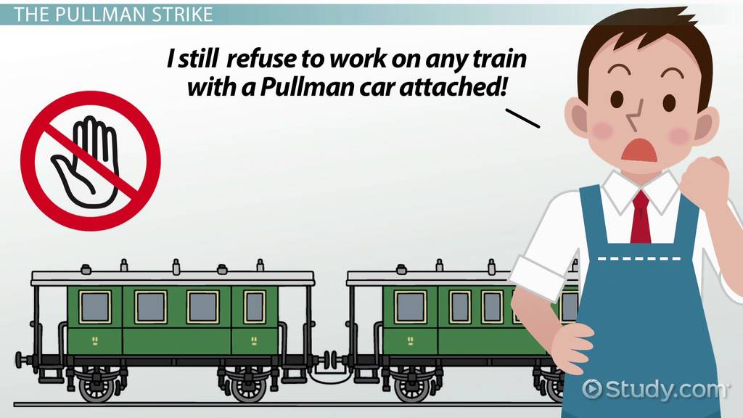

Slide 27
