Slide 1
Hey. It’s the Expansion of Industry.
Vocabulary can be found on page 154 of your book.

Slide 2
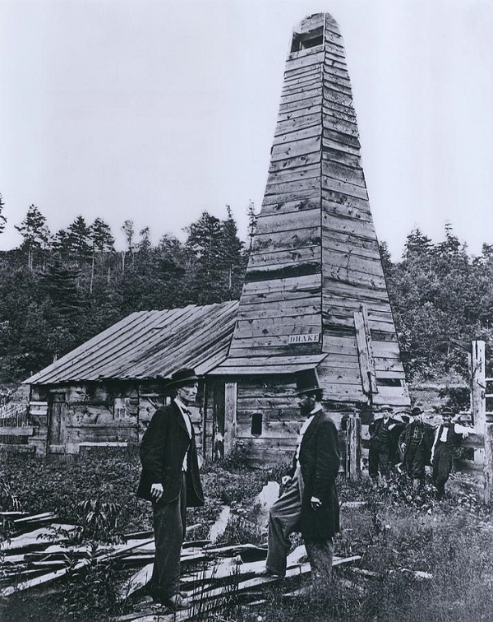
Natural Resources Fuel Industrialization
Between the 1890’s and the 1920’s the second industrial revolution occurred.
Sorry you never heard about the first one. It happened before the Civil War so the state of Florida doesn’t want me telling you about that one.
Anyways…Oil was pretty important to the second Industrial Revolution. In 1859 Edwin L. Drake first successfully used a steam engine to drill for oil near Titusville, Pennsylvania. This started an oil boom that spread to Kentucky, Ohio, Illinois, Indiana and eventually Texas.

Slide 3

Before Petroleum…
People used whale oil. The average family would keep an average of five whales at a time in a pool in the back of the house called a “whale well” or “porpoise pond”. When the family would run out of whale oil someone (usually the middle child) would have to run to the backyard and coax the whale into the “oiler”. This machine attached firmly to the head and the tail of the whale and someone (again usually the middle child) would crank the oiler to wring the oil out of the whale the way someone might wring water out of a wet towel. The first company that specialized in whales for heating the home was located in Orlando Florida, and when the market for whales declined they closed briefly and re-opened as SeaWorld and are still in business today.

Slide 4

But I Digress…
At first the petroleum was only used for kerosene (pause here for a true young Petraitis story).
And that is why no one wanted to sit next to me on the school bus!
The gasoline that was a byproduct of kerosene production was often thrown away.
Eventually when the internal combustion engine became more popular gasoline became the most important product made from petroleum.

Slide 5
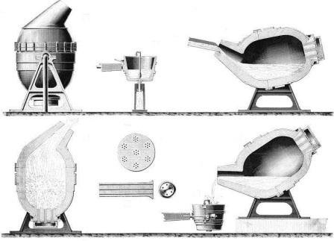
And Then!
The Bessemer process.
This was a cheap way of making iron into steel.
Steel was used for railroads, The McCormick Company used it to make mechanical reapers, John Deere made tractors from it and it allowed for buildings to have greater structural integrity so that they could be built higher.
Steel with the later invention of the elevator allowed the construction of high rise buildings changing the way Americans utilized space in urban areas. (This is actually a big deal. So be aware.)

Slide 6
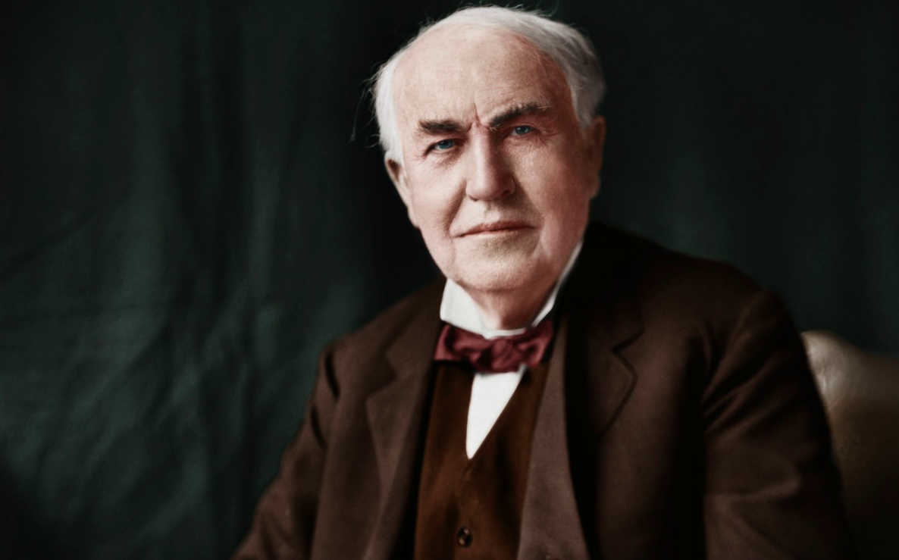
Electricity
Pretty important. Edison did some stuff with it. I could write all of this cool stuff here, or I could just have you look at the timeline on page 157 of your book and hint about the possibility of a quiz.
Oh! In 1867 the Dynamite Typewriter was invented. I assume it was probably just the brand name, but how amazing would it be if it was actually powered by dynamite?
But more importantly electricity also changed the way U.S. cities grew. Factories were no longer dependent on water power etc. Now they could operate just about anywhere there was electricity and a railroad.

Slide 7
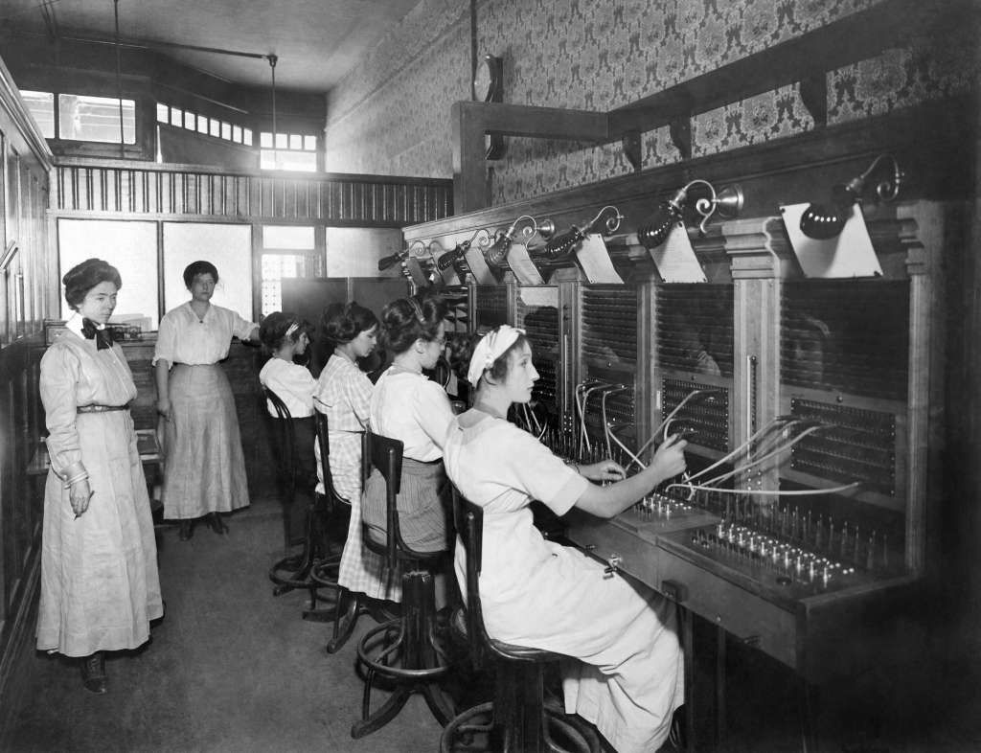
Inventions Change Lifestyles
In 1867 Christopher Sholes invents the typewriter. I mentioned it earlier but now you have more context.
Alexander Graham Bell invented the telephone in 1876. When I was a kid I always assumed that the reason when a phone “rang” was because it was Bell Telephone. For example if his name was Alexander Graham Buzzer, then phones wouldn’t have rung they would have buzzed. Now I’m not young and stupid anymore and I realize it’s just his last name.
With the invention of Typewriters and Telephones women took on more office (tertiary) jobs. In 40 years between the years of 1870 and 1910 women went from being just 5 percent of the workforce to 40 percent.
Also factory (secondary) jobs grew for women with the invention of the sewing machine (although that was 1846). Hook some electricity up to that thing and you increase factory productivity by a BILLION percent. Ok, I don’t actually know how much more productive factories became but I assume it was a lot.

Slide 8
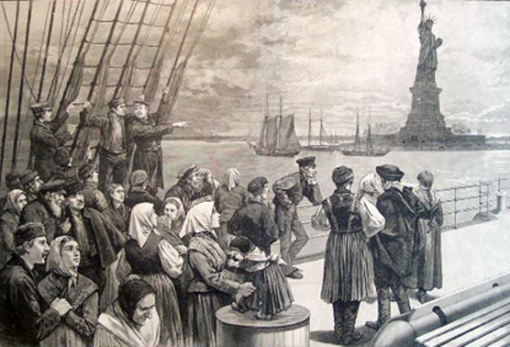
So, to sum it up…
By mechanizing factories (like shoemaking and other textile industries etc.) it decreased the average work week of workers.
This in turn made factory owners wealthier and that gave them the capital to expand their businesses.
The expansion of industry led to a shortage of workers and created an economic pull towards the United States from Europe.
The new immigration created new markets and helped grow the economy of the U.S.
The increase in factories in the U.S. led to an American population that was increasingly urban.

Slide 9
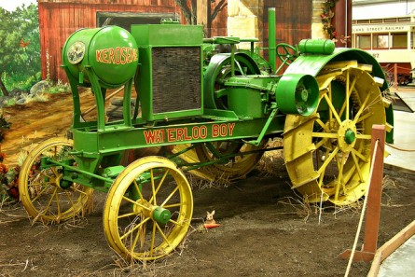

Slide 10
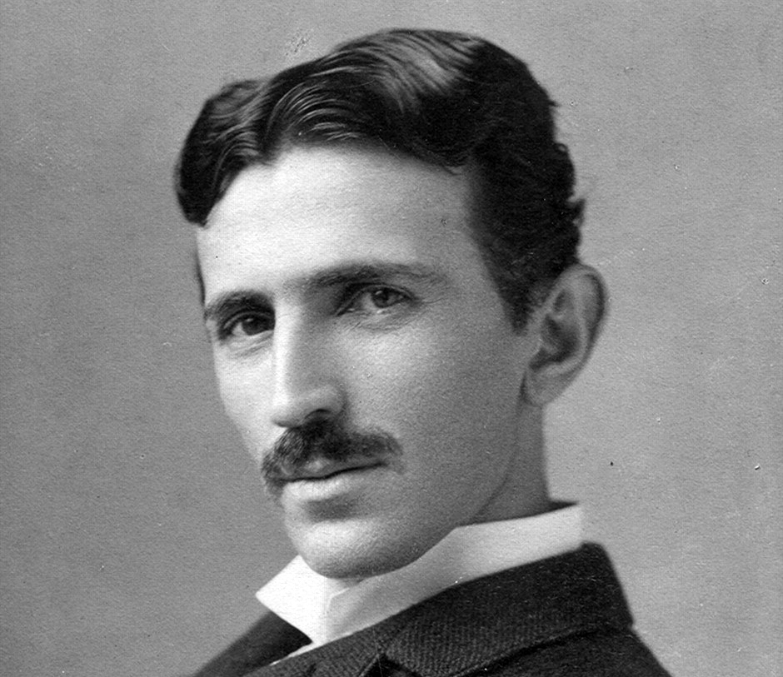

Slide 11
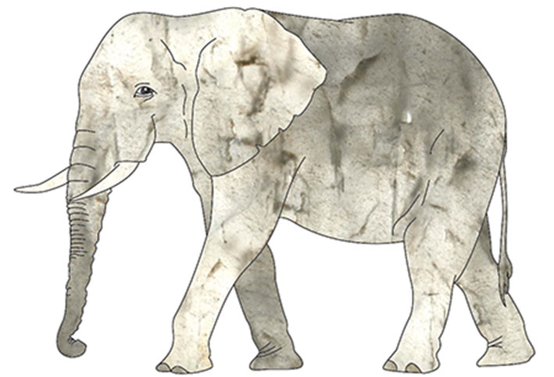

Slide 12
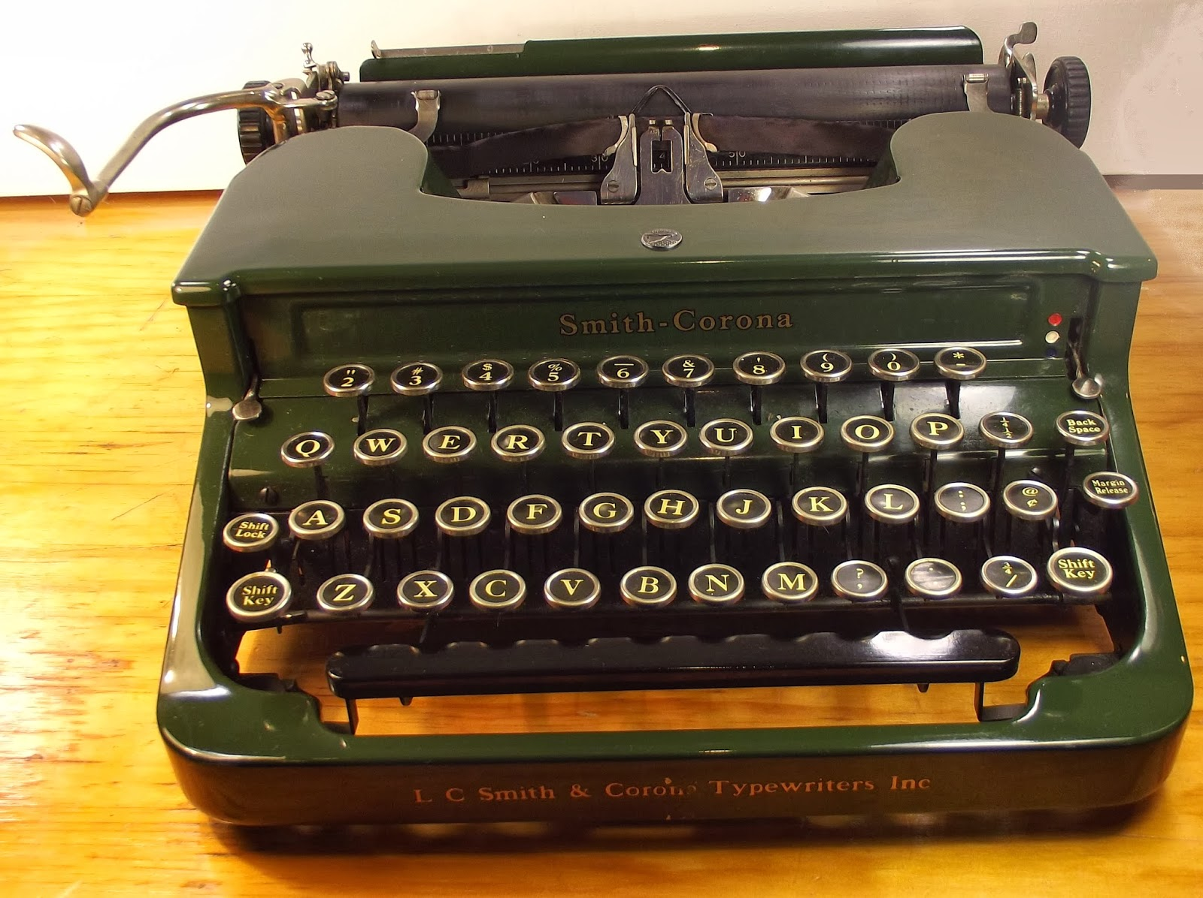

Slide 13
